Slide 1
Measles and Rubella
Global Update
July 2025

Slide 2
Distribution list
This report is posted on the WHO Immunization data portal (https://immunizationdata.who.int/global?topic=Provisional-measles-and-rubella-data&location=) and distributed by email on a monthly basis.
To join the distribution list, please send an email to Sebastien Antoni (antonis@who.int)

Slide 3
Disclaimer
Please note that all data contained within is provisional. The number of cases of measles and rubella officially reported by a member state is only available by July of each year (through the joint WHO UNICEF annual data collection exercise). If any numbers from this provisional data are quoted, they should be properly sourced with a date (i.e. "provisional data based on monthly data reported to WHO (Geneva) as of July 2025"). For official data from 1980-2024, please visit our website.

Slide 4
Data sources and limitations

Slide 5
Measles

Slide 6
Number of reported measles cases by WHO Region
2025
Region | Member States* | Suspected MR cases | Measles cases | Clin | Epi | Lab | Date Received
AFR | 42/47 | 46,689 | 22,516 | 4,421 | 8,513 | 9,582 | 2025-07
AMR | 31/35 | 16,599 | 7,240 | 3 | 1,668 | 5,569 | 2025-07
EMR | 20/21 | 61,477 | 37,992 | 18,515 | 2,741 | 16,736 | 2025-07
EUR | 47/53 | 30,536 | 22,395 | 4,240 | 4,739 | 13,416 | 2025-07
SEAR | 11/11 | 60,361 | 13,201 | 5,665 | 2,065 | 5,471 | 2025-07
WPR | 22/27 | 24,154 | 4,730 | 1,013 | 236 | 3,481 | 2025-07
Total | 173/194 | 239,816 | 108,074 | 33,857 | 19,962 | 54,255
Region | Jan | Feb | Mar | Apr | May | Jun | Jul | Aug | Sep | Oct | Nov | Dec
AFR | 4,662 | 5,156 | 5,527 | 4,030 | 2,459 | 682 | 0 | 0 | 0 | 0 | 0 | 0
AMR | 142 | 436 | 1,255 | 2,463 | 2,158 | 685 | 101 | 0 | 0 | 0 | 0 | 0
EMR | 6,731 | 7,451 | 8,826 | 7,712 | 6,061 | 1,211 | 0 | 0 | 0 | 0 | 0 | 0
EUR | 4,890 | 4,432 | 4,582 | 5,030 | 3,318 | 143 | 0 | 0 | 0 | 0 | 0 | 0
SEAR | 2,334 | 2,390 | 2,564 | 2,426 | 2,011 | 1,476 | 0 | 0 | 0 | 0 | 0 | 0
WPR | 1,248 | 1,521 | 1,034 | 505 | 422 | 0 | 0 | 0 | 0 | 0 | 0 | 0
Total | 20,007 | 21,386 | 23,788 | 22,166 | 16,429 | 4,197 | 101 | 0 | 0 | 0 | 0 | 0
2024
Region | Member States* | Suspected MR cases | Measles cases | Clin | Epi | Lab | Date Received
AFR | 43/47 | 153,308 | 86,127 | 15,884 | 51,811 | 18,432 | 2025-07
AMR | 33/35 | 17,317 | 462 | 0 | 53 | 409 | 2025-07
EMR | 21/21 | 164,426 | 96,713 | 52,179 | 6,207 | 38,327 | 2025-07
EUR | 52/53 | 149,239 | 127,420 | 21,820 | 20,131 | 85,469 | 2025-07
SEAR | 11/11 | 157,157 | 36,857 | 12,273 | 6,952 | 17,632 | 2025-07
WPR | 25/27 | 67,848 | 12,011 | 3,774 | 673 | 7,564 | 2025-07
Total | 185/194 | 709,295 | 359,590 | 105,930 | 85,827 | 167,833
Region | Jan | Feb | Mar | Apr | May | Jun | Jul | Aug | Sep | Oct | Nov | Dec
AFR | 13,630 | 15,801 | 19,233 | 11,624 | 7,782 | 4,419 | 2,969 | 2,331 | 2,501 | 2,270 | 2,207 | 1,360
AMR | 23 | 49 | 103 | 47 | 18 | 19 | 41 | 38 | 37 | 33 | 44 | 10
EMR | 13,513 | 15,485 | 15,739 | 10,912 | 10,914 | 7,073 | 5,088 | 3,559 | 3,838 | 3,695 | 3,272 | 3,625
EUR | 29,073 | 24,210 | 20,549 | 15,702 | 12,921 | 9,448 | 5,177 | 2,411 | 1,501 | 1,392 | 2,018 | 3,018
SEAR | 3,898 | 3,792 | 4,731 | 3,449 | 2,874 | 1,915 | 2,038 | 2,804 | 3,178 | 3,670 | 2,714 | 1,794
WPR | 1,013 | 1,051 | 1,235 | 1,170 | 981 | 641 | 731 | 760 | 756 | 959 | 1,340 | 1,374
Total | 61,150 | 60,388 | 61,590 | 42,904 | 35,490 | 23,515 | 16,044 | 11,903 | 11,811 | 12,019 | 11,595 | 11,181
Notes: Based on data received 2025-07 - This is surveillance data, hence for the last month, the data may be incomplete. * Member States Reporting / Total Member States in Region

Slide 7
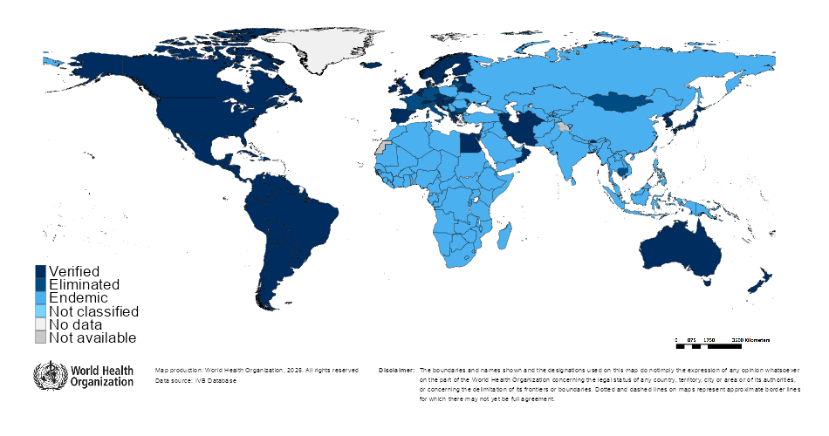

Measles/rubella verification of elimination
Measles
Region | Member States | Verified | % Verified | Eliminated | Endemic | Not classified
AFR | 47 | 0 | 0 | 0 | 47 | 0
AMR | 35 | 34 | 97 | 0 | 0 | 1
EMR | 21 | 4 | 19 | 0 | 17 | 0
EUR | 53 | 33 | 62 | 8 | 12 | 0
SEAR | 11 | 4 | 36 | 0 | 7 | 0
WPR | 27 | 6 | 22 | 15 | 6 | 0
GLOBAL | 194 | 81 | 42 | 23 | 89 | 1
Rubella
Region | Member States | Verified | % Verified | Eliminated | Endemic | Not classified
AFR | 47 | 0 | 0 | 0 | 47 | 0
AMR | 35 | 34 | 97 | 0 | 0 | 1
EMR | 21 | 4 | 19 | 0 | 17 | 0
EUR | 53 | 50 | 94 | 0 | 0 | 3
SEAR | 11 | 5 | 45 | 1 | 5 | 0
WPR | 27 | 5 | 19 | 16 | 6 | 0
GLOBAL | 194 | 98 | 51 | 17 | 75 | 4
Notes: Based on data available at WHO HQ as of 2025-07-08 . Terms used on this slide refer to the global framework for the verification of measles and rubella elimination. These terms might differ from those used by WHO Regional Offices. Verified = Elimination verified by Regional Verification Commitee (RVC); Eliminated = Eliminated transmission but no RVC verification yet.

Slide 8
Measles case distribution by month and WHO Region (2020-2025)
2020
2021
2022
2023
2024
2025
93,840 cases
59,619 cases
174,340 cases
321,889 cases
359,590 cases
108,074 cases
60,000
AFR
40,000
AMR
EMR
EUR
SEAR
WPR
20,000
0
Jan
Feb
Mar
Apr
May
Jun
Jul
Aug
Sep
Oct
Nov
Dec
Jan
Feb
Mar
Apr
May
Jun
Jul
Aug
Sep
Oct
Nov
Dec
Jan
Feb
Mar
Apr
May
Jun
Jul
Aug
Sep
Oct
Nov
Dec
Jan
Feb
Mar
Apr
May
Jun
Jul
Aug
Sep
Oct
Nov
Dec
Jan
Feb
Mar
Apr
May
Jun
Jul
Aug
Sep
Oct
Nov
Dec
Jan
Feb
Mar
Apr
May
Jun
Jul
Aug
Sep
Oct
Nov
Dec
Based on data received 2025-07 - Data Source: IVB Database - This is surveillance data, hence for the last month(s), the data may be incomplete.

Slide 9
Measles case distribution by month and WHO Region (2017-2025)
2017
2018
2019
2020
2021
2022
2023
2024
2025
168,190 cases
276,157 cases
541,401 cases
93,840 cases
59,619 cases
174,340 cases
321,889 cases
359,590 cases
108,074 cases
125,000
100,000
AFR
75,000
AMR
EMR
EUR
SEAR
50,000
WPR
25,000
0
May
Aug
Sep
May
Aug
Sep
May
Aug
Sep
May
Aug
Sep
May
Aug
Sep
May
Aug
Sep
May
Aug
Sep
May
Aug
Sep
May
Aug
Sep
Jan
Feb
Apr
Jun
Jul
Oct
Jan
Apr
Jun
Jul
Oct
Jan
Apr
Jun
Jul
Oct
Jan
Apr
Jun
Jul
Oct
Jan
Apr
Jun
Jul
Oct
Jan
Apr
Jun
Jul
Oct
Jan
Apr
Jun
Jul
Oct
Jan
Apr
Jun
Jul
Oct
Jan
Apr
Jun
Jul
Oct
Mar
Nov
Dec
Feb
Mar
Nov
Dec
Feb
Mar
Nov
Dec
Feb
Mar
Nov
Dec
Feb
Mar
Nov
Dec
Feb
Mar
Nov
Dec
Feb
Mar
Nov
Dec
Feb
Mar
Nov
Dec
Feb
Mar
Nov
Dec
Based on data received 2025-07 - Data Source: IVB Database - This is surveillance data, hence for the last month(s), the data may be incomplete.

Slide 10
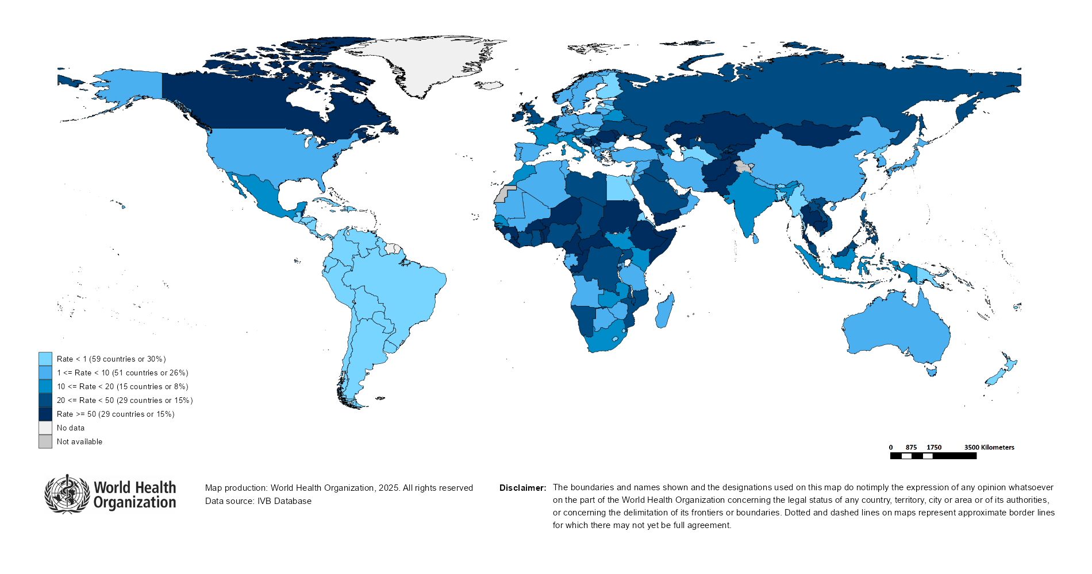
Measles Incidence Rate per Million (12M period)
Highest incidence rates | Highest incidence rates | Highest incidence rates
Country | Cases | Rate
Kyrgyzstan | 10972 | 1,526.86
Romania | 13071 | 687.40
Yemen | 25987 | 640.34
Afghanistan | 11631 | 272.72
Georgia | 696 | 182.79
Kazakhstan | 3275 | 159.04
Tajikistan | 1676 | 158.25
Serbia | 962 | 142.81
Mongolia | 394 | 113.36
Thailand | 7825 | 109.18
Notes: Based on data received 2025-07 - Surveillance data from 2024-06 to 2025-05 - Incidence: Number of cases / population * 1,000,000 - Population data: World population prospects, 2019 revision

Slide 11
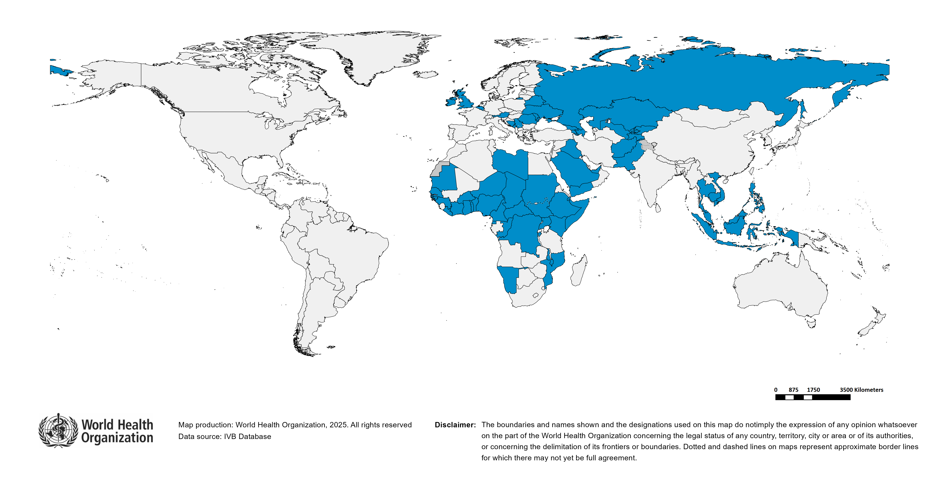
Immunization Agenda 2030 - Impact Goal 1.3
Countries provisionally meeting the large and disruptive outbreaks definition - Data from 2024-03 to 2025-02 included
Country | Cases | Rate/M | Clinical*
Kyrgyzstan | 12,463 | 1,708.42 | 46%
Romania | 25,408 | 1,343.72 | 3%
Yemen | 24,819 | 594.13 | 94%
Kazakhstan | 11,930 | 572.35 | 3%
Bosnia and Herzegovina | 1,308 | 416.55 | 80%
Iraq | 17,116 | 364.01 | 85%
Azerbaijan | 3,614 | 347.58 | 79%
Liberia | 1,572 | 274.29 | 11%
Afghanistan | 11,030 | 251.57 | 0%
Burkina Faso | 5,182 | 215.25 | 73%
Equatorial Guinea | 347 | 179.01 | 67%
Côte d'Ivoire | 5,143 | 157.22 | 0%
Ethiopia | 20,985 | 154.90 | 0%
Armenia | 436 | 147.68 | 0%
Serbia | 962 | 143.82 | 37%
South Sudan | 1,684 | 138.16 | 77%
Burundi | 1,766 | 122.72 | 1%
Thailand | 8,308 | 116.00 | 35%
Russian Federation | 15,769 | 109.51 | 0%
Georgia | 366 | 96.15 | 5%
Pakistan | 22,614 | 88.61 | 12%
Ghana | 3,094 | 88.24 | 4%
Cambodia | 1,567 | 87.80 | 0%
Niger | 2,295 | 82.21 | 38%
Republic of Moldova | 223 | 74.43 | 1%
Malaysia | 2,658 | 73.88 | 6%
Somalia | 1,420 | 72.25 | 0%
Benin | 1,013 | 68.38 | 30%
Montenegro | 41 | 64.80 | 0%
Guinea | 910 | 60.27 | 12%
Djibouti | 62 | 52.36 | 0%
Country | Cases | Rate/M | Clinical*
Monaco | 2 | 52.16 | 0%
Togo | 477 | 49.07 | 10%
Central African Republic | 257 | 46.61 | 2%
Ireland | 242 | 45.59 | 1%
Belgium | 536 | 45.58 | 7%
Congo | 265 | 40.87 | 5%
Austria | 356 | 39.06 | 0%
Chad | 811 | 38.61 | 6%
Belarus | 344 | 38.23 | 0%
DR Congo | 4,258 | 37.74 | 2%
United Kingdom of Great Britain and Northern Ireland | 2,539 | 36.51 | 0%
Philippines | 4,242 | 36.32 | 84%
United Arab Emirates | 409 | 36.05 | 12%
Nigeria | 8,450 | 35.57 | 60%
Cameroon | 952 | 31.86 | 12%
Sudan | 1,643 | 31.80 | 6%
Saudi Arabia | 1,073 | 31.04 | 0%
Uzbekistan | 1,124 | 30.33 | 1%
San Marino | 1 | 29.79 | 0%
Tajikistan | 310 | 28.74 | 0%
Mauritania | 133 | 25.02 | 0%
Malawi | 546 | 24.58 | 12%
Namibia | 75 | 24.25 | 69%
Indonesia | 6,908 | 24.18 | 55%
Libya | 177 | 23.73 | 0%
Kenya | 1,302 | 22.63 | 5%
Viet Nam | 2,243 | 22.08 | 9%
Guinea-Bissau | 49 | 21.78 | 100%
Senegal | 408 | 21.55 | 8%
Uganda | 1,064 | 20.71 | 5%
Mozambique | 713 | 20.01 | 34%
Ukraine | 780 | 20.01 | 10%
Total: 63 countries
In the frame of tracking progress towards the goals of Immunization Agenda 2030 (IA2030), an indicator has been developed by a working group in order to represent large and disruptive measles outbreaks. This indicator is defined as an incidence equal or greater than 20 reported measles cases per million population over a period of 12 months. It is important to note that measles outbreak definitions vary between countries and regions according to local context and level of progress towards regional elimination goals. This definition of large and disruptive outbreaks aims to complement and not replace the national and regional definitions, while also providing a degree of global standardization and permitting tracking of progress against a common metric.
Notes: Based on data received 2025-07 and covering the period between 2024-03 and 2025-02 - Incidence: Number of cases / 1M population - Population Data: World population prospects, 2019 revision - A high proportion of clinical cases indicates a high level of uncertainty associated with the incidence rates and the inclusion of countries in this list.

Slide 12
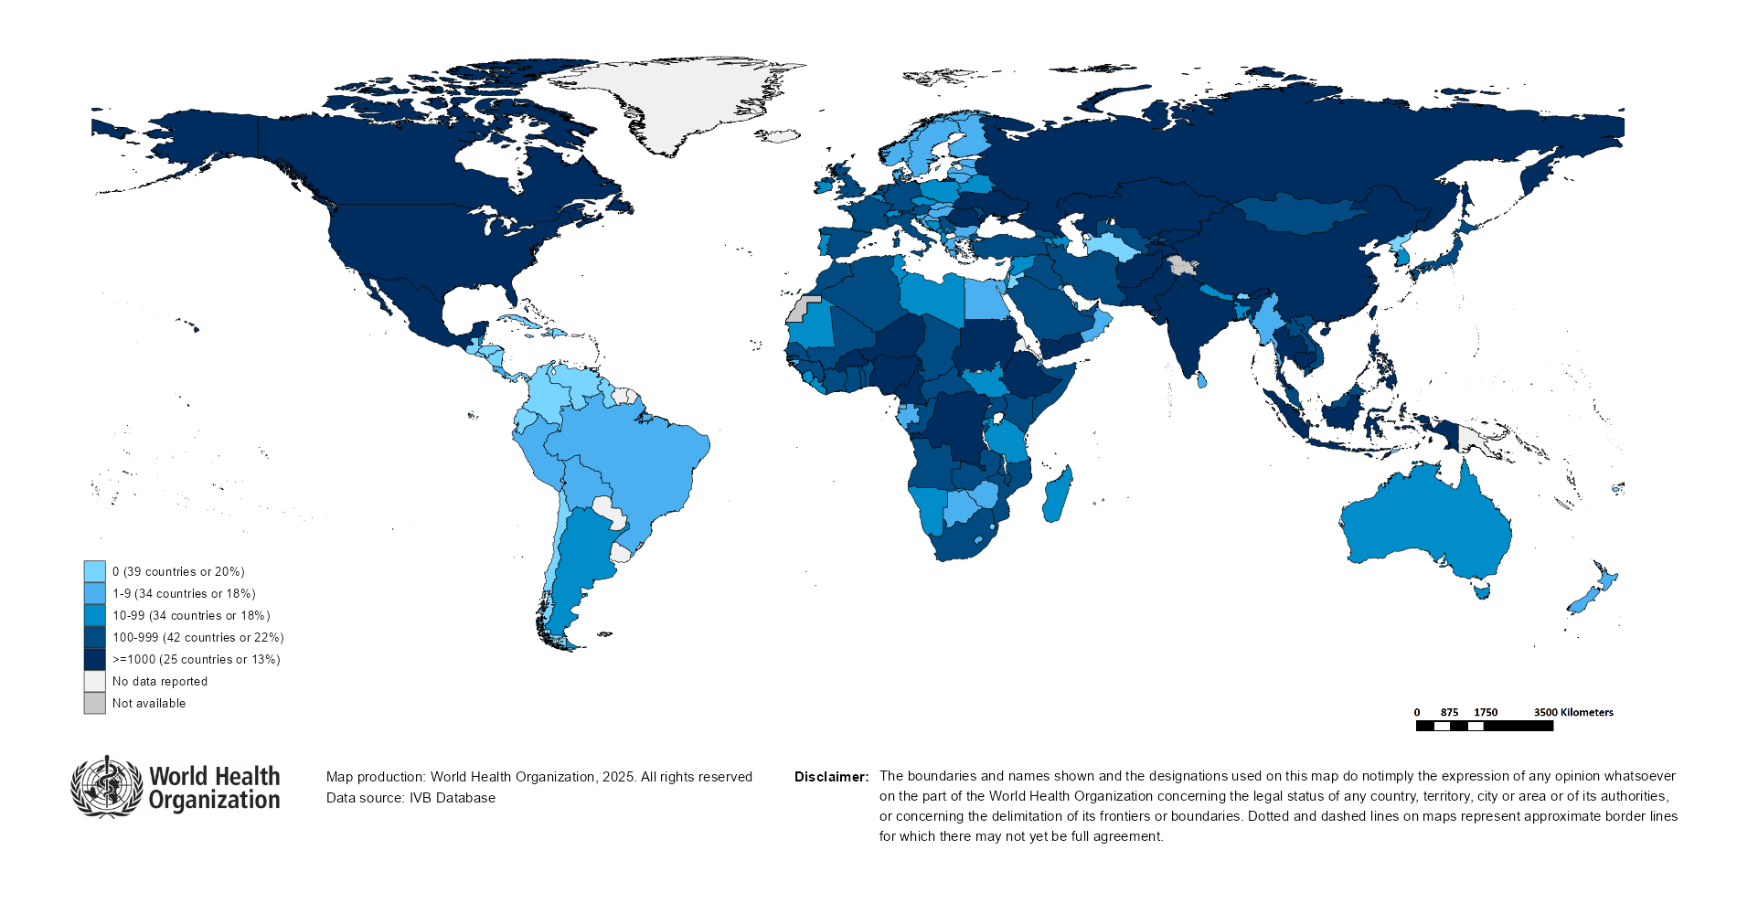
Number of Reported Measles Cases (Last 6 months)
Country | Cases*
Yemen | 15,683
Pakistan | 12,732
India** | 10,299
Kyrgyzstan | 8,497
Afghanistan | 7,615
Ethiopia | 5,370
Romania | 4,739
Nigeria | 3,395
Canada | 3,053
Russian Federation | 2,781
Notes: Based on data received 2025-07 - Surveillance data from 2024-12 to 2025-05 - * Countries with highest number of cases for the period - **WHO classifies all suspected measles cases reported from India as measles clinically compatible if a specimen was not collected as per the algorithm for classification of suspected measles in the WHO VPD Surveillance Standards. Thus numbers might be different between what WHO reports and what India reports.

Slide 13

Surveillance sensitivity reporting rate of measles and rubella (12 months, discarded cases* per 100,000 population)
Notes: Based on data received 2025-07 - Surveillance data from 2024-06 to 2025-05 - Target: >= 2 discarded cases* / 100,000 population** - * Suspected cases investigated and discarded as non-measles non-rubella using laboratory testing and/or epidemiological linkage to another etiology ** World population prospects, 2019 revision

Slide 14
Disclaimer
This document contains data provided to WHO by member states. Note that some member states only provide aggregate data to WHO, and for these, we are unable to generate a country profile. Some member states report all cases at one time point for the entire year, and thus epidemiologic curves generated are not accurate and a reporting artifact. For some countries, cases are reported by age category, not by exact age in months and/or years. Thus, age distribution/incidence is approximate. Cases classified as pending by countries are classified at WHO as clinically compatible at this time, and thus numbers might different between data shown here and provided by the member state or WHO country/regional offices.
*UN population data is used as the denominator for calculating incidence.

Slide 15
Measles case distribution (AFR), 2020-2025
2020
2021
2022
2023
2024
2025
20,000
46,747 cases
26,492 cases
64,922 cases
73,443 cases
86,127 cases
22,516 cases
15,000
10,000
5,000
0
Jan
Feb
Mar
Apr
May
Jun
Jul
Aug
Sep
Oct
Nov
Dec
Jan
Feb
Mar
Apr
May
Jun
Jul
Aug
Sep
Oct
Nov
Dec
Jan
Feb
Mar
Apr
May
Jun
Jul
Aug
Sep
Oct
Nov
Dec
Jan
Feb
Mar
Apr
May
Jun
Jul
Aug
Sep
Oct
Nov
Dec
Jan
Feb
Mar
Apr
May
Jun
Jul
Aug
Sep
Oct
Nov
Dec
Jan
Feb
Mar
Apr
May
Jun
Jul
Aug
Sep
Oct
Nov
Dec
Cameroon
DR Congo
Ethiopia
Liberia
Nigeria
Others
Based on data received 2025-07 - Data Source: IVB Database

Slide 16
Measles cases: Algeria
ELIMINATION STATUS:
ENDEMIC
2021
2022
2023
2024
2025
37 case(s)
5 case(s)
27 case(s)
76 case(s)
255 case(s)
Discarded
Clinical
100
Epi
Lab
Number of measles cases
50
0
Jan
Feb
Mar
Apr
May
Jun
Jul
Aug
Sep
Oct
Nov
Dec
Jan
Feb
Mar
Apr
May
Jun
Jul
Aug
Sep
Oct
Nov
Dec
Jan
Feb
Mar
Apr
May
Jun
Jul
Aug
Sep
Oct
Nov
Dec
Jan
Feb
Mar
Apr
May
Jun
Jul
Aug
Sep
Oct
Nov
Dec
Jan
Feb
Mar
Apr
May
Jun
Jul
Aug
Sep
Oct
Nov
Dec
Age distribution, vaccination status and incidence (last 12 months)
WHO/UNICEF Coverage Estimates (WUENIC)
80
100
75
80
60
50
Incidence rate per M
60
Number of cases
40
% Coverage
25
20
40
0
0
20
<1 yr
1-4 yrs
5-9 yrs
10-14 yrs
15-24 yrs
25-39 yrs
40+ yrs
0
Age at onset (in years)
2000
2001
2002
2003
2004
2005
2006
2007
2008
2009
2010
2011
2012
2013
2014
2015
2016
2017
2018
2019
2020
2021
2022
2023
Incidence
1 dose
Unknown
MCV1
MCV2
Based on data received 2025-07 - Data Source: IVB Database. Main epi curve was built using case-based surveillance data. Age distribution curve was built using case-based surveillance data. Coverage data from WHO/UNICEF Estimates of National Immunization Coverage (WUENIC)

Slide 17
Measles cases: Benin
ELIMINATION STATUS:
ENDEMIC
2021
2022
2023
2024
2025
27 case(s)
437 case(s)
482 case(s)
779 case(s)
596 case(s)
SIA
300
Discarded
Clinical
200
Epi
Number of measles cases
Lab
100
0
Jan
Feb
Mar
Apr
May
Jun
Jul
Aug
Sep
Oct
Nov
Dec
Jan
Feb
Mar
Apr
May
Jun
Jul
Aug
Sep
Oct
Nov
Dec
Jan
Feb
Mar
Apr
May
Jun
Jul
Aug
Sep
Oct
Nov
Dec
Jan
Feb
Mar
Apr
May
Jun
Jul
Aug
Sep
Oct
Nov
Dec
Jan
Feb
Mar
Apr
May
Jun
Jul
Aug
Sep
Oct
Nov
Dec
Age distribution, vaccination status and incidence (last 12 months)
WHO/UNICEF Coverage Estimates (WUENIC)
400
100
400
300
80
300
Incidence rate per M
60
Number of cases
200
200
% Coverage
100
100
40
0
0
20
<1 yr
1-4 yrs
5-9 yrs
10-14 yrs
15-24 yrs
25-39 yrs
40+ yrs
0
Age at onset (in years)
2000
2001
2002
2003
2004
2005
2006
2007
2008
2009
2010
2011
2012
2013
2014
2015
2016
2017
2018
2019
2020
2021
2022
2023
Incidence
2+ doses
1 dose
0 doses
Unknown
MCV1
MCV2
Based on data received 2025-07 - Data Source: IVB Database. Main epi curve was built using case-based surveillance data. Age distribution curve was built using case-based surveillance data. Coverage data from WHO/UNICEF Estimates of National Immunization Coverage (WUENIC)

Slide 18
Measles cases: Cameroon
ELIMINATION STATUS:
ENDEMIC
2021
2022
2023
2024
2025
2,000
783 case(s)
3,061 case(s)
6,175 case(s)
869 case(s)
1,422 case(s)
SIA
1,500
Discarded
Clinical
Epi
Number of measles cases
Lab
1,000
500
0
Jan
Feb
Mar
Apr
May
Jun
Jul
Aug
Sep
Oct
Nov
Dec
Jan
Feb
Mar
Apr
May
Jun
Jul
Aug
Sep
Oct
Nov
Dec
Jan
Feb
Mar
Apr
May
Jun
Jul
Aug
Sep
Oct
Nov
Dec
Jan
Feb
Mar
Apr
May
Jun
Jul
Aug
Sep
Oct
Nov
Dec
Jan
Feb
Mar
Apr
May
Jun
Jul
Aug
Sep
Oct
Nov
Dec
Age distribution, vaccination status and incidence (last 12 months)
WHO/UNICEF Coverage Estimates (WUENIC)
600
300
100
200
80
400
Number of cases
Incidence rate per M
60
200
100
% Coverage
40
0
0
20
<1 yr
1-4 yrs
5-9 yrs
10-14 yrs
15-24 yrs
25-39 yrs
40+ yrs
0
Age at onset (in years)
2000
2001
2002
2003
2004
2005
2006
2007
2008
2009
2010
2011
2012
2013
2014
2015
2016
2017
2018
2019
2020
2021
2022
2023
Incidence
2+ doses
1 dose
0 doses
Unknown
MCV1
MCV2
Based on data received 2025-07 - Data Source: IVB Database. Main epi curve was built using case-based surveillance data. Age distribution curve was built using case-based surveillance data. Coverage data from WHO/UNICEF Estimates of National Immunization Coverage (WUENIC)

Slide 19
Measles cases: Congo
ELIMINATION STATUS:
ENDEMIC
200
2021
2022
2023
2024
2025
173 case(s)
340 case(s)
392 case(s)
182 case(s)
404 case(s)
SIA
150
Discarded
Clinical
Epi
100
Number of measles cases
Lab
50
0
Jan
Feb
Mar
Apr
May
Jun
Jul
Aug
Sep
Oct
Nov
Dec
Jan
Feb
Mar
Apr
May
Jun
Jul
Aug
Sep
Oct
Nov
Dec
Jan
Feb
Mar
Apr
May
Jun
Jul
Aug
Sep
Oct
Nov
Dec
Jan
Feb
Mar
Apr
May
Jun
Jul
Aug
Sep
Oct
Nov
Dec
Jan
Feb
Mar
Apr
May
Jun
Jul
Aug
Sep
Oct
Nov
Dec
Age distribution, vaccination status and incidence (last 12 months)
WHO/UNICEF Coverage Estimates (WUENIC)
250
1500
100
200
80
150
1000
Number of cases
Incidence rate per M
60
100
500
% Coverage
50
40
0
0
20
<1 yr
1-4 yrs
5-9 yrs
10-14 yrs
15-24 yrs
25-39 yrs
40+ yrs
0
Age at onset (in years)
2000
2001
2002
2003
2004
2005
2006
2007
2008
2009
2010
2011
2012
2013
2014
2015
2016
2017
2018
2019
2020
2021
2022
2023
Incidence
2+ doses
1 dose
0 doses
Unknown
MCV1
MCV2
Based on data received 2025-07 - Data Source: IVB Database. Main epi curve was built using case-based surveillance data. Age distribution curve was built using case-based surveillance data. Coverage data from WHO/UNICEF Estimates of National Immunization Coverage (WUENIC)

Slide 20
Measles cases: Democratic Republic of the Congo
ELIMINATION STATUS:
ENDEMIC
2021
2022
2023
2024
2025
3,000
3,443 case(s)
4,365 case(s)
10,701 case(s)
5,086 case(s)
1,987 case(s)
SIA
Discarded
2,000
Clinical
Epi
Number of measles cases
Lab
1,000
0
Jan
Feb
Mar
Apr
May
Jun
Jul
Aug
Sep
Oct
Nov
Dec
Jan
Feb
Mar
Apr
May
Jun
Jul
Aug
Sep
Oct
Nov
Dec
Jan
Feb
Mar
Apr
May
Jun
Jul
Aug
Sep
Oct
Nov
Dec
Jan
Feb
Mar
Apr
May
Jun
Jul
Aug
Sep
Oct
Nov
Dec
Jan
Feb
Mar
Apr
May
Jun
Jul
Aug
Sep
Oct
Nov
Dec
Age distribution, vaccination status and incidence (last 12 months)
WHO/UNICEF Coverage Estimates (WUENIC)
1,500
100
100
80
1,000
60
Number of cases
Incidence rate per M
500
50
% Coverage
40
0
0
20
<1 yr
1-4 yrs
5-9 yrs
10-14 yrs
15-24 yrs
25-39 yrs
40+ yrs
0
Age at onset (in years)
2000
2001
2002
2003
2004
2005
2006
2007
2008
2009
2010
2011
2012
2013
2014
2015
2016
2017
2018
2019
2020
2021
2022
2023
Incidence
2+ doses
1 dose
0 doses
Unknown
MCV1
MCV2
Based on data received 2025-07 - Data Source: IVB Database. Main epi curve was built using case-based surveillance data. Age distribution curve was built using case-based surveillance data. Coverage data from WHO/UNICEF Estimates of National Immunization Coverage (WUENIC)

Slide 21
Measles cases: Ethiopia
ELIMINATION STATUS:
ENDEMIC
2021
2022
2023
2024
2025
1,947 case(s)
8,216 case(s)
16,505 case(s)
30,201 case(s)
4,876 case(s)
SIA
8,000
Discarded
6,000
Clinical
Epi
Number of measles cases
Lab
4,000
2,000
0
Jan
Feb
Mar
Apr
May
Jun
Jul
Aug
Sep
Oct
Nov
Dec
Jan
Feb
Mar
Apr
May
Jun
Jul
Aug
Sep
Oct
Nov
Dec
Jan
Feb
Mar
Apr
May
Jun
Jul
Aug
Sep
Oct
Nov
Dec
Jan
Feb
Mar
Apr
May
Jun
Jul
Aug
Sep
Oct
Nov
Dec
Jan
Feb
Mar
Apr
May
Jun
Jul
Aug
Sep
Oct
Nov
Dec
Age distribution, vaccination status and incidence (last 12 months)
WHO/UNICEF Coverage Estimates (WUENIC)
5,000
100
4,000
300
80
3,000
200
Number of cases
2,000
Incidence rate per M
60
% Coverage
1,000
100
40
0
0
20
<1 yr
1-4 yrs
5-9 yrs
10-14 yrs
15-24 yrs
25-39 yrs
40+ yrs
0
Age at onset (in years)
2000
2001
2002
2003
2004
2005
2006
2007
2008
2009
2010
2011
2012
2013
2014
2015
2016
2017
2018
2019
2020
2021
2022
2023
Incidence
2+ doses
1 dose
0 doses
Unknown
MCV1
MCV2
Based on data received 2025-07 - Data Source: IVB Database. Main epi curve was built using case-based surveillance data. Age distribution curve was built using case-based surveillance data. Coverage data from WHO/UNICEF Estimates of National Immunization Coverage (WUENIC)

Slide 22
Measles cases: Guinea
ELIMINATION STATUS:
ENDEMIC
2021
2022
2023
2024
2025
400
474 case(s)
429 case(s)
204 case(s)
635 case(s)
497 case(s)
SIA
Discarded
300
Clinical
Epi
Number of measles cases
Lab
200
100
0
Jan
Feb
Mar
Apr
May
Jun
Jul
Aug
Sep
Oct
Nov
Dec
Jan
Feb
Mar
Apr
May
Jun
Jul
Aug
Sep
Oct
Nov
Dec
Jan
Feb
Mar
Apr
May
Jun
Jul
Aug
Sep
Oct
Nov
Dec
Jan
Feb
Mar
Apr
May
Jun
Jul
Aug
Sep
Oct
Nov
Dec
Jan
Feb
Mar
Apr
May
Jun
Jul
Aug
Sep
Oct
Nov
Dec
Age distribution, vaccination status and incidence (last 12 months)
WHO/UNICEF Coverage Estimates (WUENIC)
500
100
400
300
80
300
200
60
Number of cases
Incidence rate per M
200
% Coverage
100
100
40
0
0
20
<1 yr
1-4 yrs
5-9 yrs
10-14 yrs
15-24 yrs
25-39 yrs
40+ yrs
0
Age at onset (in years)
2000
2001
2002
2003
2004
2005
2006
2007
2008
2009
2010
2011
2012
2013
2014
2015
2016
2017
2018
2019
2020
2021
2022
2023
Incidence
2+ doses
1 dose
0 doses
Unknown
MCV1
MCV2
Based on data received 2025-07 - Data Source: IVB Database. Main epi curve was built using case-based surveillance data. Age distribution curve was built using case-based surveillance data. Coverage data from WHO/UNICEF Estimates of National Immunization Coverage (WUENIC)

Slide 23
Measles cases: Malawi
ELIMINATION STATUS:
ENDEMIC
2021
2022
2023
2024
2025
43 case(s)
32 case(s)
161 case(s)
180 case(s)
840 case(s)
SIA
300
Discarded
Clinical
200
Epi
Number of measles cases
Lab
100
0
Jan
Feb
Mar
Apr
May
Jun
Jul
Aug
Sep
Oct
Nov
Dec
Jan
Feb
Mar
Apr
May
Jun
Jul
Aug
Sep
Oct
Nov
Dec
Jan
Feb
Mar
Apr
May
Jun
Jul
Aug
Sep
Oct
Nov
Dec
Jan
Feb
Mar
Apr
May
Jun
Jul
Aug
Sep
Oct
Nov
Dec
Jan
Feb
Mar
Apr
May
Jun
Jul
Aug
Sep
Oct
Nov
Dec
Age distribution, vaccination status and incidence (last 12 months)
WHO/UNICEF Coverage Estimates (WUENIC)
150
100
60
80
100
40
Number of cases
Incidence rate per M
60
50
% Coverage
20
40
0
0
20
<1 yr
1-4 yrs
5-9 yrs
10-14 yrs
15-24 yrs
25-39 yrs
40+ yrs
0
Age at onset (in years)
2000
2001
2002
2003
2004
2005
2006
2007
2008
2009
2010
2011
2012
2013
2014
2015
2016
2017
2018
2019
2020
2021
2022
2023
Incidence
2+ doses
1 dose
0 doses
Unknown
MCV1
MCV2
Based on data received 2025-07 - Data Source: IVB Database. Main epi curve was built using case-based surveillance data. Age distribution curve was built using case-based surveillance data. Coverage data from WHO/UNICEF Estimates of National Immunization Coverage (WUENIC)

Slide 24
Measles cases: Niger
ELIMINATION STATUS:
ENDEMIC
2021
2022
2023
2024
2025
788 case(s)
1,197 case(s)
680 case(s)
1,693 case(s)
1,827 case(s)
SIA
800
Discarded
600
Clinical
Epi
Number of measles cases
Lab
400
200
0
Jan
Feb
Mar
Apr
May
Jun
Jul
Aug
Sep
Oct
Nov
Dec
Jan
Feb
Mar
Apr
May
Jun
Jul
Aug
Sep
Oct
Nov
Dec
Jan
Feb
Mar
Apr
May
Jun
Jul
Aug
Sep
Oct
Nov
Dec
Jan
Feb
Mar
Apr
May
Jun
Jul
Aug
Sep
Oct
Nov
Dec
Jan
Feb
Mar
Apr
May
Jun
Jul
Aug
Sep
Oct
Nov
Dec
Age distribution, vaccination status and incidence (last 12 months)
WHO/UNICEF Coverage Estimates (WUENIC)
800
250
100
600
200
80
150
60
Number of cases
Incidence rate per M
400
100
% Coverage
200
50
40
0
0
20
<1 yr
1-4 yrs
5-9 yrs
10-14 yrs
15-24 yrs
25-39 yrs
40+ yrs
0
Age at onset (in years)
2000
2001
2002
2003
2004
2005
2006
2007
2008
2009
2010
2011
2012
2013
2014
2015
2016
2017
2018
2019
2020
2021
2022
2023
Incidence
2+ doses
1 dose
0 doses
Unknown
MCV1
MCV2
Based on data received 2025-07 - Data Source: IVB Database. Main epi curve was built using case-based surveillance data. Age distribution curve was built using case-based surveillance data. Coverage data from WHO/UNICEF Estimates of National Immunization Coverage (WUENIC)

Slide 25
Measles cases: Nigeria
ELIMINATION STATUS:
ENDEMIC
2021
2022
2023
2024
2025
10,871 case(s)
20,748 case(s)
12,224 case(s)
10,948 case(s)
3,298 case(s)
SIA
8,000
Discarded
6,000
Clinical
Epi
Number of measles cases
Lab
4,000
2,000
0
Jan
Feb
Mar
Apr
May
Jun
Jul
Aug
Sep
Oct
Nov
Dec
Jan
Feb
Mar
Apr
May
Jun
Jul
Aug
Sep
Oct
Nov
Dec
Jan
Feb
Mar
Apr
May
Jun
Jul
Aug
Sep
Oct
Nov
Dec
Jan
Feb
Mar
Apr
May
Jun
Jul
Aug
Sep
Oct
Nov
Dec
Jan
Feb
Mar
Apr
May
Jun
Jul
Aug
Sep
Oct
Nov
Dec
2,500
Age distribution, vaccination status and incidence (last 12 months)
WHO/UNICEF Coverage Estimates (WUENIC)
100
100
2,000
75
80
1,500
50
60
Number of cases
1,000
Incidence rate per M
% Coverage
500
25
40
0
0
20
<1 yr
1-4 yrs
5-9 yrs
10-14 yrs
15-24 yrs
25-39 yrs
40+ yrs
0
Age at onset (in years)
2000
2001
2002
2003
2004
2005
2006
2007
2008
2009
2010
2011
2012
2013
2014
2015
2016
2017
2018
2019
2020
2021
2022
2023
Incidence
2+ doses
1 dose
0 doses
Unknown
MCV1
MCV2
Based on data received 2025-07 - Data Source: IVB Database. Main epi curve was built using case-based surveillance data. Age distribution curve was built using case-based surveillance data. Coverage data from WHO/UNICEF Estimates of National Immunization Coverage (WUENIC)

Slide 26
Measles cases: Togo
ELIMINATION STATUS:
ENDEMIC
2021
2022
2023
2024
2025
300
43 case(s)
733 case(s)
598 case(s)
392 case(s)
439 case(s)
SIA
Discarded
Clinical
200
Epi
Number of measles cases
Lab
100
0
Jan
Feb
Mar
Apr
May
Jun
Jul
Aug
Sep
Oct
Nov
Dec
Jan
Feb
Mar
Apr
May
Jun
Jul
Aug
Sep
Oct
Nov
Dec
Jan
Feb
Mar
Apr
May
Jun
Jul
Aug
Sep
Oct
Nov
Dec
Jan
Feb
Mar
Apr
May
Jun
Jul
Aug
Sep
Oct
Nov
Dec
Jan
Feb
Mar
Apr
May
Jun
Jul
Aug
Sep
Oct
Nov
Dec
Age distribution, vaccination status and incidence (last 12 months)
WHO/UNICEF Coverage Estimates (WUENIC)
100
150
150
80
100
100
60
Number of cases
Incidence rate per M
% Coverage
50
50
40
0
0
20
<1 yr
1-4 yrs
5-9 yrs
10-14 yrs
15-24 yrs
25-39 yrs
40+ yrs
0
Age at onset (in years)
2000
2001
2002
2003
2004
2005
2006
2007
2008
2009
2010
2011
2012
2013
2014
2015
2016
2017
2018
2019
2020
2021
2022
2023
Incidence
2+ doses
1 dose
0 doses
Unknown
MCV1
MCV2
Based on data received 2025-07 - Data Source: IVB Database. Main epi curve was built using case-based surveillance data. Age distribution curve was built using case-based surveillance data. Coverage data from WHO/UNICEF Estimates of National Immunization Coverage (WUENIC)

Slide 27
Measles cases: Uganda
ELIMINATION STATUS:
ENDEMIC
2021
2022
2023
2024
2025
400
68 case(s)
187 case(s)
401 case(s)
1,071 case(s)
650 case(s)
SIA
Discarded
300
Clinical
Epi
Number of measles cases
Lab
200
100
0
Jan
Feb
Mar
Apr
May
Jun
Jul
Aug
Sep
Oct
Nov
Dec
Jan
Feb
Mar
Apr
May
Jun
Jul
Aug
Sep
Oct
Nov
Dec
Jan
Feb
Mar
Apr
May
Jun
Jul
Aug
Sep
Oct
Nov
Dec
Jan
Feb
Mar
Apr
May
Jun
Jul
Aug
Sep
Oct
Nov
Dec
Jan
Feb
Mar
Apr
May
Jun
Jul
Aug
Sep
Oct
Nov
Dec
Age distribution, vaccination status and incidence (last 12 months)
WHO/UNICEF Coverage Estimates (WUENIC)
600
200
100
400
150
80
Number of cases
Incidence rate per M
60
100
% Coverage
200
50
40
0
0
20
<1 yr
1-4 yrs
5-9 yrs
10-14 yrs
15-24 yrs
25-39 yrs
40+ yrs
0
Age at onset (in years)
2000
2001
2002
2003
2004
2005
2006
2007
2008
2009
2010
2011
2012
2013
2014
2015
2016
2017
2018
2019
2020
2021
2022
2023
Incidence
2+ doses
1 dose
0 doses
Unknown
MCV1
MCV2
Based on data received 2025-07 - Data Source: IVB Database. Main epi curve was built using case-based surveillance data. Age distribution curve was built using case-based surveillance data. Coverage data from WHO/UNICEF Estimates of National Immunization Coverage (WUENIC)

Slide 28
Measles case distribution (AMR), 2020-2025
2020
2021
2022
2023
2024
2025
8,708 cases
712 cases
169 cases
73 cases
462 cases
7,240 cases
3,000
2,000
1,000
0
Jan
Feb
Mar
Apr
May
Jun
Jul
Aug
Sep
Oct
Nov
Dec
Jan
Feb
Mar
Apr
May
Jun
Jul
Aug
Sep
Oct
Nov
Dec
Jan
Feb
Mar
Apr
May
Jun
Jul
Aug
Sep
Oct
Nov
Dec
Jan
Feb
Mar
Apr
May
Jun
Jul
Aug
Sep
Oct
Nov
Dec
Jan
Feb
Mar
Apr
May
Jun
Jul
Aug
Sep
Oct
Nov
Dec
Jan
Feb
Mar
Apr
May
Jun
Jul
Aug
Sep
Oct
Nov
Dec
Argentina
Brazil
Canada
Mexico
Others
USA
Based on data received 2025-07 - Data Source: IVB Database

Slide 29
Measles cases: Belize
ELIMINATION STATUS:
VERIFIED
2021
2022
2023
2024
2025
60
0 case(s)
0 case(s)
0 case(s)
0 case(s)
28 case(s)
Discarded
Clinical
Epi
40
Lab
Number of measles cases
20
0
Jan
Feb
Mar
Apr
May
Jun
Jul
Aug
Sep
Oct
Nov
Dec
Jan
Feb
Mar
Apr
May
Jun
Jul
Aug
Sep
Oct
Nov
Dec
Jan
Feb
Mar
Apr
May
Jun
Jul
Aug
Sep
Oct
Nov
Dec
Jan
Feb
Mar
Apr
May
Jun
Jul
Aug
Sep
Oct
Nov
Dec
Jan
Feb
Mar
Apr
May
Jun
Jul
Aug
Sep
Oct
Nov
Dec
Age distribution, vaccination status and incidence (last 12 months)
WHO/UNICEF Coverage Estimates (WUENIC)
600
100
7.5
80
400
5.0
Incidence rate per M
60
Number of cases
% Coverage
2.5
200
40
0.0
0
20
<1 yr
1-4 yrs
5-9 yrs
10-14 yrs
15-24 yrs
25-39 yrs
40+ yrs
0
Age at onset (in years)
2000
2001
2002
2003
2004
2005
2006
2007
2008
2009
2010
2011
2012
2013
2014
2015
2016
2017
2018
2019
2020
2021
2022
2023
Incidence
1 dose
Unknown
MCV1
MCV2
Based on data received 2025-07 - Data Source: IVB Database. Main epi curve was built using case-based surveillance data. Age distribution curve was built using case-based surveillance data. Coverage data from WHO/UNICEF Estimates of National Immunization Coverage (WUENIC)

Slide 30
Measles cases: Canada
ELIMINATION STATUS:
VERIFIED
2022
2023
2024
2025
3 case(s)
12 case(s)
147 case(s)
3,426 case(s)
Discarded
Clinical
Epi
1,000
Lab
Number of measles cases
500
0
Jan
Feb
Mar
Apr
May
Jun
Jul
Aug
Sep
Oct
Nov
Dec
Jan
Feb
Mar
Apr
May
Jun
Jul
Aug
Sep
Oct
Nov
Dec
Jan
Feb
Mar
Apr
May
Jun
Jul
Aug
Sep
Oct
Nov
Dec
Jan
Feb
Mar
Apr
May
Jun
Jul
Aug
Sep
Oct
Nov
Dec
Age distribution, vaccination status and incidence (last 12 months)
WHO/UNICEF Coverage Estimates (WUENIC)
800
100
600
400
80
400
Incidence rate per M
60
Number of cases
% Coverage
200
200
40
0
0
20
<1 yr
1-4 yrs
5-9 yrs
10-14 yrs
15-24 yrs
25-39 yrs
40+ yrs
0
Age at onset (in years)
2000
2001
2002
2003
2004
2005
2006
2007
2008
2009
2010
2011
2012
2013
2014
2015
2016
2017
2018
2019
2020
2021
2022
2023
Incidence
Unknown
MCV1
MCV2
Based on data received 2025-07 - Data Source: IVB Database. Main epi curve was built using case-based surveillance data. Age distribution curve was built using case-based surveillance data. Coverage data from WHO/UNICEF Estimates of National Immunization Coverage (WUENIC)

Slide 31
Measles cases: Mexico
ELIMINATION STATUS:
VERIFIED
2021
2022
2023
2024
2025
2,500
0 case(s)
0 case(s)
0 case(s)
7 case(s)
2,475 case(s)
Discarded
Clinical
2,000
Epi
Lab
1,500
Number of measles cases
1,000
500
0
Jan
Feb
Mar
Apr
May
Jun
Jul
Aug
Sep
Oct
Nov
Dec
Jan
Feb
Mar
Apr
May
Jun
Jul
Aug
Sep
Oct
Nov
Dec
Jan
Feb
Mar
Apr
May
Jun
Jul
Aug
Sep
Oct
Nov
Dec
Jan
Feb
Mar
Apr
May
Jun
Jul
Aug
Sep
Oct
Nov
Dec
Jan
Feb
Mar
Apr
May
Jun
Jul
Aug
Sep
Oct
Nov
Dec
Age distribution, vaccination status and incidence (last 12 months)
WHO/UNICEF Coverage Estimates (WUENIC)
800
100
75
600
80
50
60
400
Incidence rate per M
Number of cases
% Coverage
200
25
40
0
0
20
<1 yr
1-4 yrs
5-9 yrs
10-14 yrs
15-24 yrs
25-39 yrs
40+ yrs
0
Age at onset (in years)
2000
2001
2002
2003
2004
2005
2006
2007
2008
2009
2010
2011
2012
2013
2014
2015
2016
2017
2018
2019
2020
2021
2022
2023
Incidence
2+ doses
1 dose
Unknown
MCV1
MCV2
Based on data received 2025-07 - Data Source: IVB Database. Main epi curve was built using case-based surveillance data. Age distribution curve was built using case-based surveillance data. Coverage data from WHO/UNICEF Estimates of National Immunization Coverage (WUENIC)

Slide 32
Measles cases: United States of America
ELIMINATION STATUS:
VERIFIED
2021
2022
2023
2024
2025
51 case(s)
121 case(s)
59 case(s)
285 case(s)
1,267 case(s)
Discarded
Clinical
400
Epi
Lab
Number of measles cases
200
0
Jan
Feb
Mar
Apr
May
Jun
Jul
Aug
Sep
Oct
Nov
Dec
Jan
Feb
Mar
Apr
May
Jun
Jul
Aug
Sep
Oct
Nov
Dec
Jan
Feb
Mar
Apr
May
Jun
Jul
Aug
Sep
Oct
Nov
Dec
Jan
Feb
Mar
Apr
May
Jun
Jul
Aug
Sep
Oct
Nov
Dec
Jan
Feb
Mar
Apr
May
Jun
Jul
Aug
Sep
Oct
Nov
Dec
WHO/UNICEF Coverage Estimates (WUENIC)
100
80
No data available or no case reported in the last 12 months
60
% Coverage
40
20
0
2000
2001
2002
2003
2004
2005
2006
2007
2008
2009
2010
2011
2012
2013
2014
2015
2016
2017
2018
2019
2020
2021
2022
2023
MCV1
MCV2
Based on data received 2025-07 - Data Source: IVB Database. Main epi curve was built using aggregate surveillance data. Coverage data from WHO/UNICEF Estimates of National Immunization Coverage (WUENIC)

Slide 33
Measles case distribution (EMR), 2020-2025
2020
2021
2022
2023
2024
2025
9,829 cases
24,329 cases
57,465 cases
90,855 cases
96,713 cases
37,992 cases
16,000
12,000
8,000
4,000
0
Jan
Feb
Mar
Apr
May
Jun
Jul
Aug
Sep
Oct
Nov
Dec
Jan
Feb
Mar
Apr
May
Jun
Jul
Aug
Sep
Oct
Nov
Dec
Jan
Feb
Mar
Apr
May
Jun
Jul
Aug
Sep
Oct
Nov
Dec
Jan
Feb
Mar
Apr
May
Jun
Jul
Aug
Sep
Oct
Nov
Dec
Jan
Feb
Mar
Apr
May
Jun
Jul
Aug
Sep
Oct
Nov
Dec
Jan
Feb
Mar
Apr
May
Jun
Jul
Aug
Sep
Oct
Nov
Dec
Afghanistan
Iraq
Others
Pakistan
Somalia
Yemen
Based on data received 2025-07 - Data Source: IVB Database

Slide 34
Measles cases: Afghanistan
ELIMINATION STATUS:
ENDEMIC
2021
2022
2023
2024
2025
3,028 case(s)
5,119 case(s)
2,529 case(s)
9,769 case(s)
7,037 case(s)
SIA
2,000
Discarded
Clinical
Epi
Number of measles cases
Lab
1,000
0
Jan
Feb
Mar
Apr
May
Jun
Jul
Aug
Sep
Oct
Nov
Dec
Jan
Feb
Mar
Apr
May
Jun
Jul
Aug
Sep
Oct
Nov
Dec
Jan
Feb
Mar
Apr
May
Jun
Jul
Aug
Sep
Oct
Nov
Dec
Jan
Feb
Mar
Apr
May
Jun
Jul
Aug
Sep
Oct
Nov
Dec
Jan
Feb
Mar
Apr
May
Jun
Jul
Aug
Sep
Oct
Nov
Dec
Age distribution, vaccination status and incidence (last 12 months)
WHO/UNICEF Coverage Estimates (WUENIC)
2500
100
4,000
2000
80
1500
60
Number of cases
Incidence rate per M
2,000
1000
% Coverage
500
40
0
0
20
<1 yr
1-4 yrs
5-9 yrs
10-14 yrs
15-24 yrs
25-39 yrs
40+ yrs
0
Age at onset (in years)
2000
2001
2002
2003
2004
2005
2006
2007
2008
2009
2010
2011
2012
2013
2014
2015
2016
2017
2018
2019
2020
2021
2022
2023
Incidence
2+ doses
1 dose
0 doses
Unknown
MCV1
MCV2
Based on data received 2025-07 - Data Source: IVB Database. Main epi curve was built using case-based surveillance data. Age distribution curve was built using case-based surveillance data. Coverage data from WHO/UNICEF Estimates of National Immunization Coverage (WUENIC)

Slide 35
Measles cases: Pakistan
ELIMINATION STATUS:
ENDEMIC
2021
2022
2023
2024
2025
9,313 case(s)
7,917 case(s)
17,515 case(s)
24,263 case(s)
12,390 case(s)
SIA
10,000
Discarded
Clinical
Epi
Number of measles cases
Lab
5,000
0
Jan
Feb
Mar
Apr
May
Jun
Jul
Aug
Sep
Oct
Nov
Dec
Jan
Feb
Mar
Apr
May
Jun
Jul
Aug
Sep
Oct
Nov
Dec
Jan
Feb
Mar
Apr
May
Jun
Jul
Aug
Sep
Oct
Nov
Dec
Jan
Feb
Mar
Apr
May
Jun
Jul
Aug
Sep
Oct
Nov
Dec
Jan
Feb
Mar
Apr
May
Jun
Jul
Aug
Sep
Oct
Nov
Dec
Age distribution, vaccination status and incidence (last 12 months)
WHO/UNICEF Coverage Estimates (WUENIC)
10,000
1200
100
7,500
900
80
600
60
Number of cases
5,000
Incidence rate per M
% Coverage
2,500
300
40
0
0
20
<1 yr
1-4 yrs
5-9 yrs
10-14 yrs
15-24 yrs
25-39 yrs
40+ yrs
0
Age at onset (in years)
2000
2001
2002
2003
2004
2005
2006
2007
2008
2009
2010
2011
2012
2013
2014
2015
2016
2017
2018
2019
2020
2021
2022
2023
Incidence
2+ doses
1 dose
0 doses
Unknown
MCV1
MCV2
Based on data received 2025-07 - Data Source: IVB Database. Main epi curve was built using case-based surveillance data. Age distribution curve was built using case-based surveillance data. Coverage data from WHO/UNICEF Estimates of National Immunization Coverage (WUENIC)

Slide 36
Measles cases: Somalia
ELIMINATION STATUS:
ENDEMIC
3,000
2021
2022
2023
2024
2025
6,029 case(s)
17,361 case(s)
1,781 case(s)
1,516 case(s)
466 case(s)
SIA
Discarded
2,000
Clinical
Epi
Number of measles cases
Lab
1,000
0
Jan
Feb
Mar
Apr
May
Jun
Jul
Aug
Sep
Oct
Nov
Dec
Jan
Feb
Mar
Apr
May
Jun
Jul
Aug
Sep
Oct
Nov
Dec
Jan
Feb
Mar
Apr
May
Jun
Jul
Aug
Sep
Oct
Nov
Dec
Jan
Feb
Mar
Apr
May
Jun
Jul
Aug
Sep
Oct
Nov
Dec
Jan
Feb
Mar
Apr
May
Jun
Jul
Aug
Sep
Oct
Nov
Dec
Age distribution, vaccination status and incidence (last 12 months)
WHO/UNICEF Coverage Estimates (WUENIC)
100
400
300
80
200
60
Number of cases
Incidence rate per M
200
% Coverage
100
40
0
0
20
<1 yr
1-4 yrs
5-9 yrs
10-14 yrs
15-24 yrs
25-39 yrs
40+ yrs
0
Age at onset (in years)
2000
2001
2002
2003
2004
2005
2006
2007
2008
2009
2010
2011
2012
2013
2014
2015
2016
2017
2018
2019
2020
2021
2022
2023
Incidence
2+ doses
1 dose
0 doses
MCV1
MCV2
Based on data received 2025-07 - Data Source: IVB Database. Main epi curve was built using a combination of case-based and aggregate surveillance data. Age distribution curve was built using case-based surveillance data. Coverage data from WHO/UNICEF Estimates of National Immunization Coverage (WUENIC)

Slide 37
Measles cases: Yemen
ELIMINATION STATUS:
ENDEMIC
2021
2022
2023
2024
2025
4,825 case(s)
23,924 case(s)
49,571 case(s)
23,990 case(s)
14,748 case(s)
SIA
6,000
Discarded
Clinical
Epi
4,000
Number of measles cases
Lab
2,000
0
Jan
Feb
Mar
Apr
May
Jun
Jul
Aug
Sep
Oct
Nov
Dec
Jan
Feb
Mar
Apr
May
Jun
Jul
Aug
Sep
Oct
Nov
Dec
Jan
Feb
Mar
Apr
May
Jun
Jul
Aug
Sep
Oct
Nov
Dec
Jan
Feb
Mar
Apr
May
Jun
Jul
Aug
Sep
Oct
Nov
Dec
Jan
Feb
Mar
Apr
May
Jun
Jul
Aug
Sep
Oct
Nov
Dec
Age distribution, vaccination status and incidence (last 12 months)
WHO/UNICEF Coverage Estimates (WUENIC)
100
10,000
3000
80
2000
60
Number of cases
Incidence rate per M
5,000
% Coverage
1000
40
0
0
20
<1 yr
1-4 yrs
5-9 yrs
10-14 yrs
15-24 yrs
25-39 yrs
40+ yrs
0
Age at onset (in years)
2000
2001
2002
2003
2004
2005
2006
2007
2008
2009
2010
2011
2012
2013
2014
2015
2016
2017
2018
2019
2020
2021
2022
2023
Incidence
2+ doses
1 dose
0 doses
Unknown
MCV1
MCV2
Based on data received 2025-07 - Data Source: IVB Database. Main epi curve was built using case-based surveillance data. Age distribution curve was built using case-based surveillance data. Coverage data from WHO/UNICEF Estimates of National Immunization Coverage (WUENIC)

Slide 38
Measles case distribution (EUR), 2020-2025
2020
2021
2022
2023
2024
2025
30,000
12,193 cases
150 cases
901 cases
60,944 cases
127,420 cases
22,395 cases
20,000
10,000
0
Jan
Feb
Mar
Apr
May
Jun
Jul
Aug
Sep
Oct
Nov
Dec
Jan
Feb
Mar
Apr
May
Jun
Jul
Aug
Sep
Oct
Nov
Dec
Jan
Feb
Mar
Apr
May
Jun
Jul
Aug
Sep
Oct
Nov
Dec
Jan
Feb
Mar
Apr
May
Jun
Jul
Aug
Sep
Oct
Nov
Dec
Jan
Feb
Mar
Apr
May
Jun
Jul
Aug
Sep
Oct
Nov
Dec
Jan
Feb
Mar
Apr
May
Jun
Jul
Aug
Sep
Oct
Nov
Dec
Azerbaijan
Kazakhstan
Kyrgyzstan
Others
Romania
Russian Federation
Based on data received 2025-07 - Data Source: IVB Database

Slide 39
Measles cases: Georgia
ELIMINATION STATUS:
ENDEMIC
2021
2022
2023
2024
2025
300
5 case(s)
12 case(s)
39 case(s)
350 case(s)
464 case(s)
Discarded
Clinical
Epi
200
Lab
Number of measles cases
100
0
Jan
Feb
Mar
Apr
May
Jun
Jul
Aug
Sep
Oct
Nov
Dec
Jan
Feb
Mar
Apr
May
Jun
Jul
Aug
Sep
Oct
Nov
Dec
Jan
Feb
Mar
Apr
May
Jun
Jul
Aug
Sep
Oct
Nov
Dec
Jan
Feb
Mar
Apr
May
Jun
Jul
Aug
Sep
Oct
Nov
Dec
Jan
Feb
Mar
Apr
May
Jun
Jul
Aug
Sep
Oct
Nov
Dec
Age distribution, vaccination status and incidence (last 12 months)
WHO/UNICEF Coverage Estimates (WUENIC)
150
100
750
80
100
500
60
Number of cases
Incidence rate per M
50
% Coverage
250
40
0
0
20
<1 yr
1-4 yrs
5-9 yrs
10-14 yrs
15-24 yrs
25-39 yrs
40+ yrs
0
Age at onset (in years)
2000
2001
2002
2003
2004
2005
2006
2007
2008
2009
2010
2011
2012
2013
2014
2015
2016
2017
2018
2019
2020
2021
2022
2023
Incidence
2+ doses
1 dose
0 doses
Unknown
MCV1
MCV2
Based on data received 2025-07 - Data Source: IVB Database. Main epi curve was built using case-based surveillance data. Age distribution curve was built using case-based surveillance data. Coverage data from WHO/UNICEF Estimates of National Immunization Coverage (WUENIC)

Slide 40
Measles cases: Kyrgyzstan
ELIMINATION STATUS:
ENDEMIC
2021
2022
2023
2024
2025
4 case(s)
23 case(s)
7,463 case(s)
14,408 case(s)
7,399 case(s)
SIA
3,000
Discarded
Clinical
2,000
Epi
Number of measles cases
Lab
1,000
0
Jan
Feb
Mar
Apr
May
Jun
Jul
Aug
Sep
Oct
Nov
Dec
Jan
Feb
Mar
Apr
May
Jun
Jul
Aug
Sep
Oct
Nov
Dec
Jan
Feb
Mar
Apr
May
Jun
Jul
Aug
Sep
Oct
Nov
Dec
Jan
Feb
Mar
Apr
May
Jun
Jul
Aug
Sep
Oct
Nov
Dec
Jan
Feb
Mar
Apr
May
Jun
Jul
Aug
Sep
Oct
Nov
Dec
Age distribution, vaccination status and incidence (last 12 months)
WHO/UNICEF Coverage Estimates (WUENIC)
4,000
25000
100
3,000
20000
80
15000
60
Number of cases
2,000
Incidence rate per M
10000
% Coverage
1,000
5000
40
0
0
20
<1 yr
1-4 yrs
5-9 yrs
10-14 yrs
15-24 yrs
25-39 yrs
40+ yrs
0
Age at onset (in years)
2000
2001
2002
2003
2004
2005
2006
2007
2008
2009
2010
2011
2012
2013
2014
2015
2016
2017
2018
2019
2020
2021
2022
2023
Incidence
2+ doses
1 dose
0 doses
Unknown
MCV1
MCV2
Based on data received 2025-07 - Data Source: IVB Database. Main epi curve was built using case-based surveillance data. Age distribution curve was built using case-based surveillance data. Coverage data from WHO/UNICEF Estimates of National Immunization Coverage (WUENIC)

Slide 41
Measles cases: Republic of Moldova
ELIMINATION STATUS:
VERIFIED
2021
2022
2023
2024
2025
80
0 case(s)
0 case(s)
3 case(s)
221 case(s)
119 case(s)
Discarded
Clinical
Epi
60
Lab
Number of measles cases
40
20
0
Jan
Feb
Mar
Apr
May
Jun
Jul
Aug
Sep
Oct
Nov
Dec
Jan
Feb
Mar
Apr
May
Jun
Jul
Aug
Sep
Oct
Nov
Dec
Jan
Feb
Mar
Apr
May
Jun
Jul
Aug
Sep
Oct
Nov
Dec
Jan
Feb
Mar
Apr
May
Jun
Jul
Aug
Sep
Oct
Nov
Dec
Jan
Feb
Mar
Apr
May
Jun
Jul
Aug
Sep
Oct
Nov
Dec
Age distribution, vaccination status and incidence (last 12 months)
WHO/UNICEF Coverage Estimates (WUENIC)
600
100
60
80
400
40
Incidence rate per M
60
Number of cases
% Coverage
20
200
40
0
0
20
<1 yr
1-4 yrs
5-9 yrs
10-14 yrs
15-24 yrs
25-39 yrs
40+ yrs
0
Age at onset (in years)
2000
2001
2002
2003
2004
2005
2006
2007
2008
2009
2010
2011
2012
2013
2014
2015
2016
2017
2018
2019
2020
2021
2022
2023
Incidence
2+ doses
1 dose
0 doses
Unknown
MCV1
MCV2
Based on data received 2025-07 - Data Source: IVB Database. Main epi curve was built using case-based surveillance data. Age distribution curve was built using case-based surveillance data. Coverage data from WHO/UNICEF Estimates of National Immunization Coverage (WUENIC)

Slide 42
Measles cases: Tajikistan
ELIMINATION STATUS:
RE-ESTABLISHED
2021
2022
2023
2024
2025
1,500
10 case(s)
451 case(s)
294 case(s)
0 case(s)
1,676 case(s)
SIA
Discarded
1,000
Clinical
Epi
Number of measles cases
Lab
500
0
Jan
Feb
Mar
Apr
May
Jun
Jul
Aug
Sep
Oct
Nov
Dec
Jan
Feb
Mar
Apr
May
Jun
Jul
Aug
Sep
Oct
Nov
Dec
Jan
Feb
Mar
Apr
May
Jun
Jul
Aug
Sep
Oct
Nov
Dec
Jan
Feb
Mar
Apr
May
Jun
Jul
Aug
Sep
Oct
Nov
Dec
Jan
Feb
Mar
Apr
May
Jun
Jul
Aug
Sep
Oct
Nov
Dec
Age distribution, vaccination status and incidence (last 12 months)
WHO/UNICEF Coverage Estimates (WUENIC)
1,200
100
1000
80
800
Number of cases
Incidence rate per M
60
400
500
% Coverage
40
0
0
20
<1 yr
1-4 yrs
5-9 yrs
10-14 yrs
15-24 yrs
25-39 yrs
40+ yrs
0
Age at onset (in years)
2000
2001
2002
2003
2004
2005
2006
2007
2008
2009
2010
2011
2012
2013
2014
2015
2016
2017
2018
2019
2020
2021
2022
2023
Incidence
1 dose
0 doses
Unknown
MCV1
MCV2
Based on data received 2025-07 - Data Source: IVB Database. Main epi curve was built using case-based surveillance data. Age distribution curve was built using case-based surveillance data. Coverage data from WHO/UNICEF Estimates of National Immunization Coverage (WUENIC)

Slide 43
Measles cases: Ukraine
ELIMINATION STATUS:
ENDEMIC
2021
2022
2023
2024
2025
15 case(s)
11 case(s)
66 case(s)
473 case(s)
914 case(s)
Discarded
300
Clinical
Epi
Lab
200
Number of measles cases
100
0
Jan
Feb
Mar
Apr
May
Jun
Jul
Aug
Sep
Oct
Nov
Dec
Jan
Feb
Mar
Apr
May
Jun
Jul
Aug
Sep
Oct
Nov
Dec
Jan
Feb
Mar
Apr
May
Jun
Jul
Aug
Sep
Oct
Nov
Dec
Jan
Feb
Mar
Apr
May
Jun
Jul
Aug
Sep
Oct
Nov
Dec
Jan
Feb
Mar
Apr
May
Jun
Jul
Aug
Sep
Oct
Nov
Dec
Age distribution, vaccination status and incidence (last 12 months)
WHO/UNICEF Coverage Estimates (WUENIC)
600
100
300
80
200
400
Number of cases
Incidence rate per M
60
200
% Coverage
100
40
0
0
20
<1 yr
1-4 yrs
5-9 yrs
10-14 yrs
15-19 yrs
20-29 yrs
30+ yrs
0
Age at onset (in years)
2000
2001
2002
2003
2004
2005
2006
2007
2008
2009
2010
2011
2012
2013
2014
2015
2016
2017
2018
2019
2020
2021
2022
2023
Incidence
2+ doses
1 dose
0 doses
Unknown
MCV1
MCV2
Based on data received 2025-07 - Data Source: IVB Database. Main epi curve was built using case-based surveillance data. Age distribution curve was built using case-based surveillance data. Coverage data from WHO/UNICEF Estimates of National Immunization Coverage (WUENIC)

Slide 44
Measles case distribution (SEAR (excl. India)), 2020-2025
2020
2021
2022
2023
2024
2025
4,452 cases
715 cases
5,914 cases
22,038 cases
16,090 cases
2,658 cases
3,000
2,000
1,000
0
Jan
Feb
Mar
Apr
May
Jun
Jul
Aug
Sep
Oct
Nov
Dec
Jan
Feb
Mar
Apr
May
Jun
Jul
Aug
Sep
Oct
Nov
Dec
Jan
Feb
Mar
Apr
May
Jun
Jul
Aug
Sep
Oct
Nov
Dec
Jan
Feb
Mar
Apr
May
Jun
Jul
Aug
Sep
Oct
Nov
Dec
Jan
Feb
Mar
Apr
May
Jun
Jul
Aug
Sep
Oct
Nov
Dec
Jan
Feb
Mar
Apr
May
Jun
Jul
Aug
Sep
Oct
Nov
Dec
Bangladesh
Indonesia
Nepal
Others
Sri Lanka
Thailand
Based on data received 2025-07 - Data Source: IVB Database

Slide 45
Measles cases: Indonesia
ELIMINATION STATUS:
ENDEMIC
2021
2022
2023
2024
2025
8,000
290 case(s)
5,362 case(s)
19,879 case(s)
7,191 case(s)
1,841 case(s)
Discarded
Clinical
6,000
Epi
Lab
Number of measles cases
4,000
2,000
0
Jan
Feb
Mar
Apr
May
Jun
Jul
Aug
Sep
Oct
Nov
Dec
Jan
Feb
Mar
Apr
May
Jun
Jul
Aug
Sep
Oct
Nov
Dec
Jan
Feb
Mar
Apr
May
Jun
Jul
Aug
Sep
Oct
Nov
Dec
Jan
Feb
Mar
Apr
May
Jun
Jul
Aug
Sep
Oct
Nov
Dec
Jan
Feb
Mar
Apr
May
Jun
Jul
Aug
Sep
Oct
Nov
Dec
Age distribution, vaccination status and incidence (last 12 months)
WHO/UNICEF Coverage Estimates (WUENIC)
200
100
150
10
80
Number of cases
Incidence rate per M
60
100
% Coverage
5
40
50
0
0
20
<1 yr
1-4 yrs
5-9 yrs
10-14 yrs
15-24 yrs
25-39 yrs
40+ yrs
0
Age at onset (in years)
2000
2001
2002
2003
2004
2005
2006
2007
2008
2009
2010
2011
2012
2013
2014
2015
2016
2017
2018
2019
2020
2021
2022
2023
Incidence
2+ doses
1 dose
0 doses
Unknown
MCV1
MCV2
Based on data received 2025-07 - Data Source: IVB Database. Main epi curve was built using aggregate surveillance data. Age distribution curve was built using case-based surveillance data. Coverage data from WHO/UNICEF Estimates of National Immunization Coverage (WUENIC)

Slide 46
Measles case distribution (SEAR, India), 2020-2025
2020
2021
2022
2023
2024
2025
16,000
5,598 cases
6,025 cases
43,578 cases
68,794 cases
20,767 cases
10,543 cases
12,000
8,000
4,000
0
Jan
Feb
Mar
Apr
May
Jun
Jul
Aug
Sep
Oct
Nov
Dec
Jan
Feb
Mar
Apr
May
Jun
Jul
Aug
Sep
Oct
Nov
Dec
Jan
Feb
Mar
Apr
May
Jun
Jul
Aug
Sep
Oct
Nov
Dec
Jan
Feb
Mar
Apr
May
Jun
Jul
Aug
Sep
Oct
Nov
Dec
Jan
Feb
Mar
Apr
May
Jun
Jul
Aug
Sep
Oct
Nov
Dec
Jan
Feb
Mar
Apr
May
Jun
Jul
Aug
Sep
Oct
Nov
Dec
India
Based on data received 2025-07 - Data Source: IVB Database

Slide 47
Measles cases: India
ELIMINATION STATUS:
ENDEMIC
2021
2022
2023
2024
2025
30,000
6,025 case(s)
43,578 case(s)
68,794 case(s)
20,767 case(s)
10,543 case(s)
SIA
Discarded
20,000
Clinical
Epi
Number of measles cases
Lab
10,000
0
Jan
Feb
Mar
Apr
May
Jun
Jul
Aug
Sep
Oct
Nov
Dec
Jan
Feb
Mar
Apr
May
Jun
Jul
Aug
Sep
Oct
Nov
Dec
Jan
Feb
Mar
Apr
May
Jun
Jul
Aug
Sep
Oct
Nov
Dec
Jan
Feb
Mar
Apr
May
Jun
Jul
Aug
Sep
Oct
Nov
Dec
Jan
Feb
Mar
Apr
May
Jun
Jul
Aug
Sep
Oct
Nov
Dec
Age distribution, vaccination status and incidence (last 12 months)
WHO/UNICEF Coverage Estimates (WUENIC)
100
4,000
100
80
Number of cases
Incidence rate per M
60
2,000
50
% Coverage
40
0
0
20
<1 yr
1-4 yrs
5-9 yrs
10-14 yrs
15-24 yrs
25-39 yrs
40+ yrs
0
Age at onset (in years)
2000
2001
2002
2003
2004
2005
2006
2007
2008
2009
2010
2011
2012
2013
2014
2015
2016
2017
2018
2019
2020
2021
2022
2023
Incidence
2+ doses
1 dose
Unknown
MCV1
MCV2
Based on data received 2025-07 - Data Source: IVB Database. Main epi curve was built using case-based surveillance data. Age distribution curve was built using case-based surveillance data. Coverage data from WHO/UNICEF Estimates of National Immunization Coverage (WUENIC)

Slide 48
Measles case distribution (WPR), 2020-2025
2020
2021
2022
2023
2024
2025
6,313 cases
1,196 cases
1,391 cases
5,742 cases
12,011 cases
4,730 cases
2,000
1,500
1,000
500
0
Jan
Feb
Mar
Apr
May
Jun
Jul
Aug
Sep
Oct
Nov
Dec
Jan
Feb
Mar
Apr
May
Jun
Jul
Aug
Sep
Oct
Nov
Dec
Jan
Feb
Mar
Apr
May
Jun
Jul
Aug
Sep
Oct
Nov
Dec
Jan
Feb
Mar
Apr
May
Jun
Jul
Aug
Sep
Oct
Nov
Dec
Jan
Feb
Mar
Apr
May
Jun
Jul
Aug
Sep
Oct
Nov
Dec
Jan
Feb
Mar
Apr
May
Jun
Jul
Aug
Sep
Oct
Nov
Dec
Cambodia
China
Malaysia
Others
Philippines
Viet Nam
Based on data received 2025-07 - Data Source: IVB Database

Slide 49
Measles cases: Cambodia
ELIMINATION STATUS:
ELIMINATED
2021
2022
2023
2024
2025
5 case(s)
13 case(s)
11 case(s)
666 case(s)
1,098 case(s)
SIA
1,000
Discarded
Clinical
Epi
Number of measles cases
Lab
500
0
Jan
Feb
Mar
Apr
May
Jun
Jul
Aug
Sep
Oct
Nov
Dec
Jan
Feb
Mar
Apr
May
Jun
Jul
Aug
Sep
Oct
Nov
Dec
Jan
Feb
Mar
Apr
May
Jun
Jul
Aug
Sep
Oct
Nov
Dec
Jan
Feb
Mar
Apr
May
Jun
Jul
Aug
Sep
Oct
Nov
Dec
Jan
Feb
Mar
Apr
May
Jun
Jul
Aug
Sep
Oct
Nov
Dec
Age distribution, vaccination status and incidence (last 12 months)
WHO/UNICEF Coverage Estimates (WUENIC)
2000
100
600
1500
80
400
Incidence rate per M
60
Number of cases
1000
% Coverage
200
500
40
0
0
20
<1 yr
1-4 yrs
5-9 yrs
10-14 yrs
15-24 yrs
25-39 yrs
40+ yrs
0
Age at onset (in years)
2000
2001
2002
2003
2004
2005
2006
2007
2008
2009
2010
2011
2012
2013
2014
2015
2016
2017
2018
2019
2020
2021
2022
2023
Incidence
2+ doses
1 dose
0 doses
Unknown
MCV1
MCV2
Based on data received 2025-07 - Data Source: IVB Database. Main epi curve was built using case-based surveillance data. Age distribution curve was built using case-based surveillance data. Coverage data from WHO/UNICEF Estimates of National Immunization Coverage (WUENIC)

Slide 50
Measles cases: Lao People's Democratic Republic
ELIMINATION STATUS:
ENDEMIC
2021
2022
2023
2024
2025
300
1 case(s)
0 case(s)
2 case(s)
1 case(s)
284 case(s)
SIA
Discarded
200
Clinical
Epi
Number of measles cases
Lab
100
0
Jan
Feb
Mar
Apr
May
Jun
Jul
Aug
Sep
Oct
Nov
Dec
Jan
Feb
Mar
Apr
May
Jun
Jul
Aug
Sep
Oct
Nov
Dec
Jan
Feb
Mar
Apr
May
Jun
Jul
Aug
Sep
Oct
Nov
Dec
Jan
Feb
Mar
Apr
May
Jun
Jul
Aug
Sep
Oct
Nov
Dec
Jan
Feb
Mar
Apr
May
Jun
Jul
Aug
Sep
Oct
Nov
Dec
Age distribution, vaccination status and incidence (last 12 months)
WHO/UNICEF Coverage Estimates (WUENIC)
400
100
100
300
80
200
60
Number of cases
Incidence rate per M
50
% Coverage
100
40
0
0
20
<1 yr
1-4 yrs
5-9 yrs
10-14 yrs
15-24 yrs
25-39 yrs
40+ yrs
0
Age at onset (in years)
2000
2001
2002
2003
2004
2005
2006
2007
2008
2009
2010
2011
2012
2013
2014
2015
2016
2017
2018
2019
2020
2021
2022
2023
Incidence
2+ doses
1 dose
0 doses
Unknown
MCV1
MCV2
Based on data received 2025-07 - Data Source: IVB Database. Main epi curve was built using case-based surveillance data. Age distribution curve was built using case-based surveillance data. Coverage data from WHO/UNICEF Estimates of National Immunization Coverage (WUENIC)

Slide 51
Measles cases: Viet Nam
ELIMINATION STATUS:
ENDEMIC
2021
2022
2023
2024
2025
180 case(s)
38 case(s)
98 case(s)
2,105 case(s)
151 case(s)
SIA
600
Discarded
Clinical
400
Epi
Number of measles cases
Lab
200
0
Jan
Feb
Mar
Apr
May
Jun
Jul
Aug
Sep
Oct
Nov
Dec
Jan
Feb
Mar
Apr
May
Jun
Jul
Aug
Sep
Oct
Nov
Dec
Jan
Feb
Mar
Apr
May
Jun
Jul
Aug
Sep
Oct
Nov
Dec
Jan
Feb
Mar
Apr
May
Jun
Jul
Aug
Sep
Oct
Nov
Dec
Jan
Feb
Mar
Apr
May
Jun
Jul
Aug
Sep
Oct
Nov
Dec
Age distribution, vaccination status and incidence (last 12 months)
WHO/UNICEF Coverage Estimates (WUENIC)
1,000
200
100
750
150
80
Incidence rate per M
60
Number of cases
500
100
% Coverage
250
50
40
0
0
20
<1 yr
1-4 yrs
5-9 yrs
10-14 yrs
15-24 yrs
25-39 yrs
40+ yrs
0
Age at onset (in years)
2000
2001
2002
2003
2004
2005
2006
2007
2008
2009
2010
2011
2012
2013
2014
2015
2016
2017
2018
2019
2020
2021
2022
2023
Incidence
2+ doses
1 dose
Unknown
MCV1
MCV2
Based on data received 2025-07 - Data Source: IVB Database. Main epi curve was built using case-based surveillance data. Age distribution curve was built using case-based surveillance data. Coverage data from WHO/UNICEF Estimates of National Immunization Coverage (WUENIC)

Slide 52
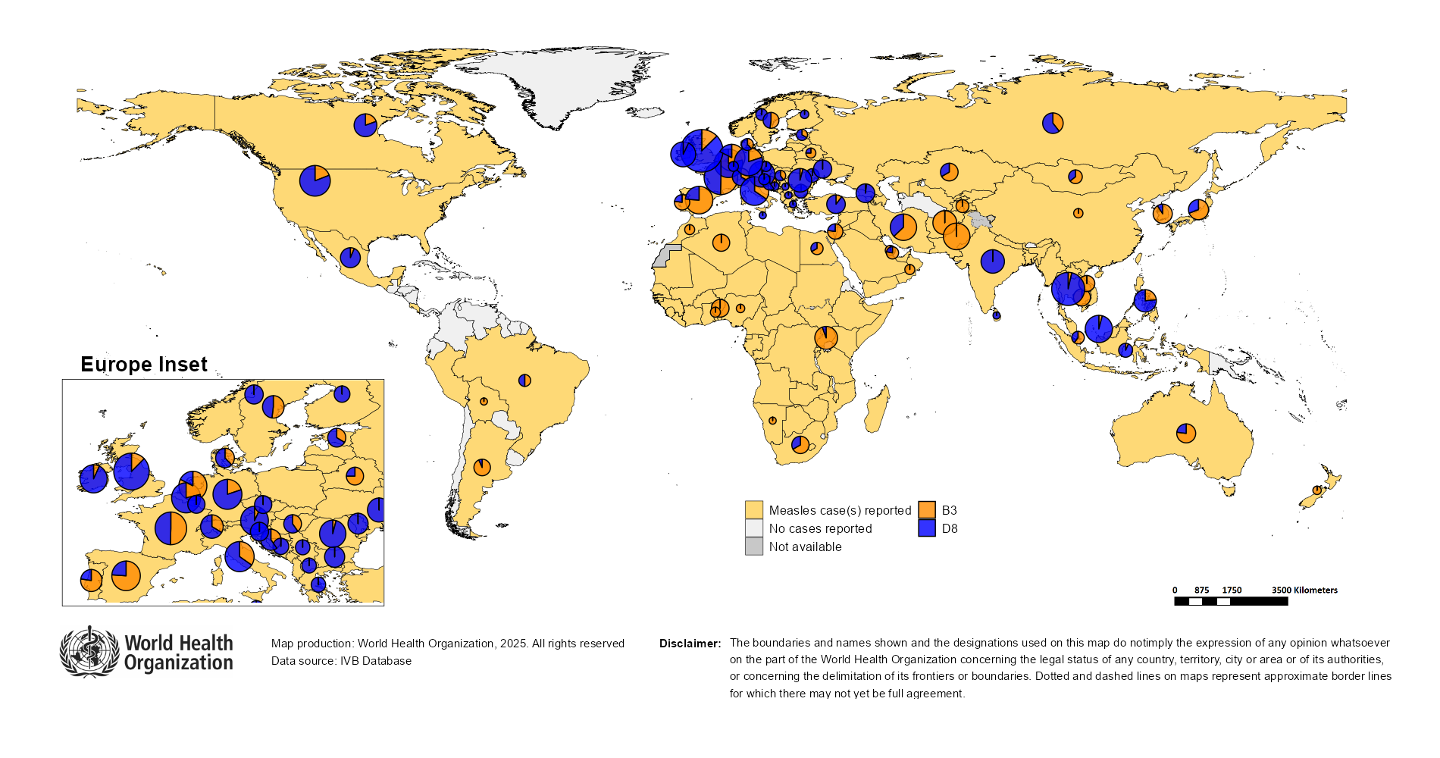
Distribution of measles genotypes (last 12 months)
Data Source: MeaNS2 database (Genotypes) and IVB Database (Incidence) as of 2025-07-08 and covering the period between 2024-06 and 2025-05 - Pie charts proportional to the number of sequenced viruses

Slide 53
Rubella

Slide 54
Number of reported rubella cases by WHO Region
2025
Region | Member States* | Rubella cases | Clin | Epi | Lab | Date Received
AFR | 41/47 | 1,685 | 0 | 0 | 1,685 | 2025-07
AMR | 24/35 | 0 | 0 | 0 | 0 | 2025-07
EMR | 20/21 | 484 | 217 | 3 | 264 | 2025-07
EUR | 27/53 | 320 | 7 | 7 | 306 | 2025-07
SEAR | 11/11 | 1,461 | 0 | 26 | 1,435 | 2025-07
WPR | 13/27 | 321 | 89 | 0 | 232 | 2025-07
Total | 136/194 | 4,271 | 313 | 36 | 3,922
Region | Jan | Feb | Mar | Apr | May | Jun | Jul | Aug | Sep | Oct | Nov | Dec
AFR | 373 | 385 | 392 | 304 | 159 | 72 | 0 | 0 | 0 | 0 | 0 | 0
AMR | 0 | 0 | 0 | 0 | 0 | 0 | 0 | 0 | 0 | 0 | 0 | 0
EMR | 120 | 146 | 99 | 73 | 46 | 0 | 0 | 0 | 0 | 0 | 0 | 0
EUR | 103 | 78 | 72 | 52 | 12 | 3 | 0 | 0 | 0 | 0 | 0 | 0
SEAR | 320 | 314 | 264 | 261 | 239 | 63 | 0 | 0 | 0 | 0 | 0 | 0
WPR | 49 | 68 | 72 | 72 | 60 | 0 | 0 | 0 | 0 | 0 | 0 | 0
Total | 965 | 991 | 899 | 762 | 516 | 138 | 0 | 0 | 0 | 0 | 0 | 0
2024
Region | Member States* | Rubella cases | Clin | Epi | Lab | Date Received
AFR | 43/47 | 15,738 | 0 | 0 | 15,738 | 2025-07
AMR | 28/35 | 0 | 0 | 0 | 0 | 2025-07
EMR | 21/21 | 3,521 | 2,516 | 188 | 817 | 2025-07
EUR | 32/53 | 320 | 29 | 2 | 289 | 2025-07
SEAR | 11/11 | 3,134 | 0 | 106 | 3,028 | 2025-07
WPR | 16/27 | 661 | 81 | 0 | 580 | 2025-07
Total | 151/194 | 23,374 | 2,626 | 296 | 20,452
Region | Jan | Feb | Mar | Apr | May | Jun | Jul | Aug | Sep | Oct | Nov | Dec
AFR | 357 | 345 | 645 | 567 | 832 | 574 | 396 | 1,897 | 4,278 | 3,063 | 1,880 | 904
AMR | 0 | 0 | 0 | 0 | 0 | 0 | 0 | 0 | 0 | 0 | 0 | 0
EMR | 339 | 363 | 367 | 288 | 353 | 287 | 235 | 268 | 385 | 361 | 196 | 79
EUR | 12 | 17 | 16 | 38 | 51 | 34 | 32 | 44 | 26 | 19 | 16 | 15
SEAR | 276 | 310 | 317 | 265 | 262 | 217 | 244 | 214 | 245 | 292 | 272 | 220
WPR | 44 | 33 | 75 | 68 | 63 | 44 | 47 | 64 | 45 | 70 | 50 | 58
Total | 1,028 | 1,068 | 1,420 | 1,226 | 1,561 | 1,156 | 954 | 2,487 | 4,979 | 3,805 | 2,414 | 1,276
Notes: Based on data received 2025-07 - This is surveillance data, hence for the last month, the data may be incomplete. * Member States Reporting / Total Member States in Region

Slide 55
Rubella case distribution by month and WHO Region (2017-2025)
2017
2018
2019
2020
2021
2022
2023
2024
2025
10,712 cases
17,045 cases
47,766 cases
7,501 cases
7,410 cases
12,620 cases
10,421 cases
23,374 cases
4,271 cases
9,000
AFR
AMR
6,000
EMR
EUR
SEAR
WPR
3,000
0
May
Sep
Sep
Sep
Sep
Sep
Sep
Sep
Sep
Sep
Apr
Aug
May
Aug
May
Aug
May
Aug
May
Aug
May
Aug
May
Aug
May
Aug
May
Aug
Jan
Jun
Jul
Oct
Jan
Apr
Jun
Jul
Oct
Jan
Apr
Jun
Jul
Oct
Jan
Apr
Jun
Jul
Oct
Jan
Apr
Jun
Jul
Oct
Jan
Apr
Jun
Jul
Oct
Jan
Apr
Jun
Jul
Oct
Jan
Apr
Jun
Jul
Oct
Jan
Apr
Jun
Jul
Oct
Feb
Mar
Nov
Dec
Feb
Mar
Nov
Dec
Feb
Mar
Nov
Dec
Feb
Mar
Nov
Dec
Feb
Mar
Nov
Dec
Feb
Mar
Nov
Dec
Feb
Mar
Nov
Dec
Feb
Mar
Nov
Dec
Feb
Mar
Nov
Dec
Based on data received 2025-07 - Data Source: IVB Database - This is surveillance data, hence for the last month(s), the data may be incomplete.

Slide 56
Rubella case distribution by month and WHO Region (2023-2025)
2023
2024
2025
10,421 cases
23,374 cases
4,271 cases
5,000
4,000
AFR
3,000
EMR
EUR
SEAR
2,000
WPR
1,000
0
Jan
Feb
Mar
Apr
May
Jun
Jul
Aug
Sep
Oct
Nov
Dec
Jan
Feb
Mar
Apr
May
Jun
Jul
Aug
Sep
Oct
Nov
Dec
Jan
Feb
Mar
Apr
May
Jun
Jul
Aug
Sep
Oct
Nov
Dec
Based on data received 2025-07 - Data Source: IVB Database - This is surveillance data, hence for the last month(s), the data may be incomplete.

Slide 57
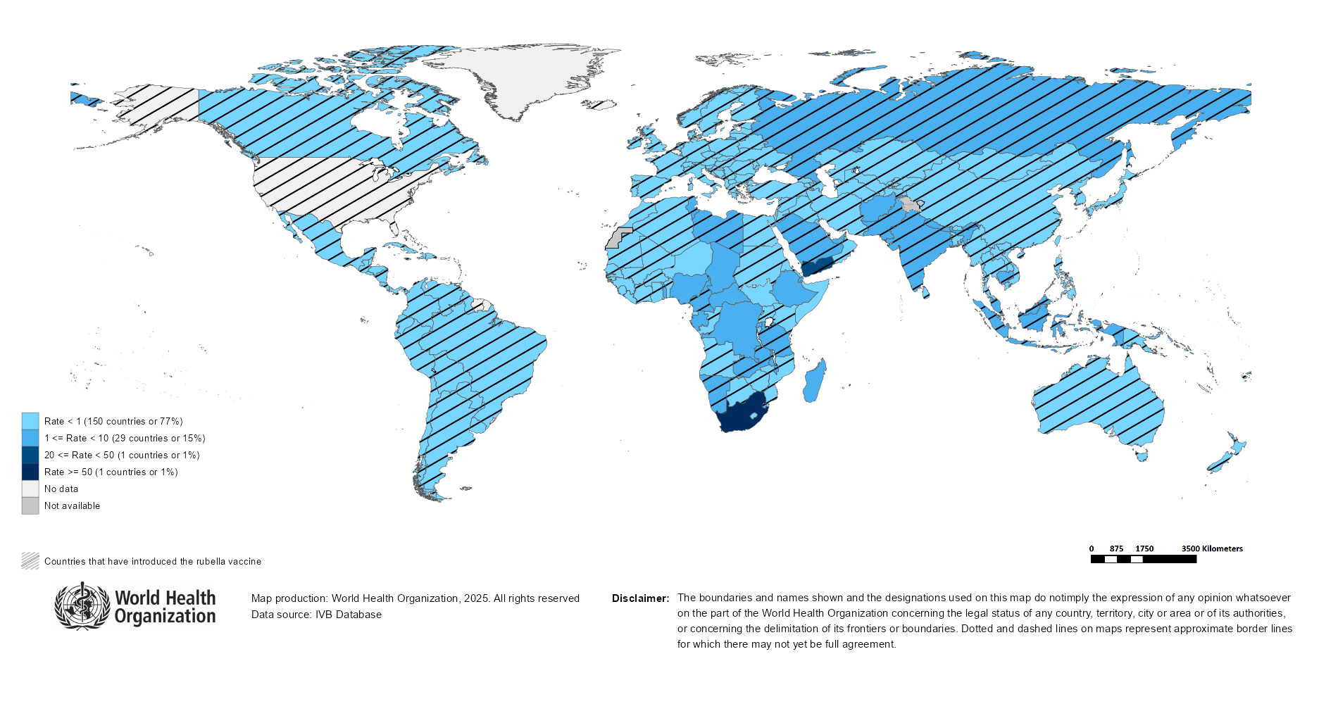
Rubella Incidence Rate per Million (12M period)
Highest incidence rates | Highest incidence rates | Highest incidence rates
Country | Cases | Rate
South Africa | 12454 | 194.57
Yemen | 1675 | 41.27
Chad | 149 | 7.34
Gabon | 16 | 6.30
Central African Republic | 23 | 4.31
Libya | 25 | 3.39
United Republic of Tanzania | 232 | 3.38
DR Congo | 344 | 3.15
Russian Federation | 451 | 3.11
Madagascar | 98 | 3.07
Notes: Based on data received 2025-07 - Surveillance data from 2024-12 to 2025-05 - Incidence: Number of cases / population * 1,000,000 - Population data: World population prospects, 2019 revision

Slide 58
Disclaimer
This document contains data provided to WHO by member states. Note that some member states only provide aggregate data to WHO, and for these, we are unable to generate a country profile. Some member states report all cases at one time point for the entire year, and thus epidemiologic curves generated are not accurate and a reporting artifact. For some countries, cases are reported by age category, not by exact age in months and/or years. Thus, age distribution/incidence is approximate. Cases classified as pending by countries are classified at WHO as clinically compatible at this time, and thus numbers might different between data shown here and provided by the member state or WHO country/regional offices.
*UN population data is used as the denominator for calculating incidence.

Slide 59
Rubella cases (AFR)
AFR Rubella Case Distribution (January 2023-July 2025)
Top 10 countries (last 12 M) | Top 10 countries (last 12 M) | Top 10 countries (last 12 M) | Top 10 countries (last 12 M)
Country | RCV in RI | Cases | % of Total
South Africa | No | 12047 | 85
Nigeria | No | 537 | 4
DR Congo | No | 341 | 2
Ethiopia | No | 326 | 2
Others | - | 266 | 2
United Republic of Tanzania | 2014 | 221 | 2
Chad | No | 144 | 1
Madagascar | No | 93 | 1
Malawi | 2017 | 50 | 0
Uganda | 2019 | 48 | 0
Cameroon | 2015 | 30 | 0
2023
2024
2025
4,000
3,000
(lab + epi-linked + clinical)
Number of cases
2,000
1,000
0
Jan
Feb
Mar
Apr
May
Jun
Jul
Aug
Sep
Oct
Nov
Dec
Jan
Feb
Mar
Apr
May
Jun
Jul
Aug
Sep
Oct
Nov
Dec
Jan
Feb
Mar
Apr
May
Jun
Jul
Aug
Sep
Oct
Nov
Dec
Introduced less than 5 years ago
Introduced more than 5 years ago
Not introduced in EPI
(after 2020)
(2020 and before)
AFR Age distribution of Rubella IgM+ cases by vaccine introduction status in the National EPI Programme (last 12 Months)
1500
1000
(IgM+ only)
Number of cases
500
0
0
10
20
30
40
Age at onset (in years)
Rubella vaccine introduced before 1 January 2025
Rubella vaccine not introduced before 1 January 2025
Notes: Based on data received 2025-07 Data Source: IVB Database.

Slide 60
Rubella cases (EMR)
EMR Rubella Case Distribution (January 2023-July 2025)
Top 10 countries (last 12 M) | Top 10 countries (last 12 M) | Top 10 countries (last 12 M) | Top 10 countries (last 12 M)
Country | RCV in RI | Cases | % of Total
Yemen | 2015 | 1482 | 74
Pakistan | 2022 | 218 | 11
Afghanistan | No | 96 | 5
Saudi Arabia | 1982 | 43 | 2
Sudan | 2024 | 40 | 2
Others | - | 38 | 2
Egypt | 1999 | 25 | 1
Libya | 1993 | 24 | 1
Syrian Arab Republic | 1999 | 18 | 1
Iran (Islamic Republic of) | 2004 | 13 | 1
United Arab Emirates | 1985 | 11 | 1
400
2023
2024
2025
300
(lab + epi-linked + clinical)
200
Number of cases
100
0
Jan
Feb
Mar
Apr
May
Jun
Jul
Aug
Sep
Oct
Nov
Dec
Jan
Feb
Mar
Apr
May
Jun
Jul
Aug
Sep
Oct
Nov
Dec
Jan
Feb
Mar
Apr
May
Jun
Jul
Aug
Sep
Oct
Nov
Dec
Introduced less than 5 years ago
Introduced more than 5 years ago
Not introduced in EPI
(after 2020)
(2020 and before)
EMR Age distribution of Rubella IgM+ cases by vaccine introduction status in the National EPI Programme (last 12 Months)
400
300
(IgM+ only)
200
Number of cases
100
0
0
10
20
30
40
Age at onset (in years)
Rubella vaccine introduced before 1 January 2025
Rubella vaccine not introduced before 1 January 2025
Notes: Based on data received 2025-07 Data Source: IVB Database.

Slide 61
Rubella cases: Afghanistan
ELIMINATION STATUS:
ENDEMIC
2022
2023
2024
2025
50
Total = 197 cases
Total = 229 cases
Total = 152 cases
Total = 61 cases
40
30
Rubella cases
20
10
0
Jan
Feb
Mar
Apr
May
Jun
Jul
Aug
Sep
Oct
Nov
Dec
Jan
Feb
Mar
Apr
May
Jun
Jul
Aug
Sep
Oct
Nov
Dec
Jan
Feb
Mar
Apr
May
Jun
Jul
Aug
Sep
Oct
Nov
Dec
Jan
Feb
Mar
Apr
May
Jun
Jul
Aug
Sep
Oct
Nov
Dec
Clinical
Epi
Lab
Age distribution, sex and incidence (Last 12 months)
WHO/UNICEF Coverage Estimates (WUENIC)
40
15
100
30
80
10
Number of cases
Incidence rate per M
60
20
% Coverage
10
5
40
0
0
20
<1 yr
1-4 yrs
5-9 yrs
10-14 yrs
15-24 yrs
25-39 yrs
40+ yrs
0
Age at onset (in years)
2000
2001
2002
2003
2004
2005
2006
2007
2008
2009
2010
2011
2012
2013
2014
2015
2016
2017
2018
2019
2020
2021
2022
2023
Incidence
Male
Female
Unknown
RCV1

Slide 62
Rubella cases: Yemen
ELIMINATION STATUS:
ENDEMIC
2022
2023
2024
2025
400
Total = 1,654 cases
Total = 186 cases
Total = 2,665 cases
Total = 249 cases
300
Rubella cases
200
100
0
Jan
Feb
Mar
Apr
May
Jun
Jul
Aug
Sep
Oct
Nov
Dec
Jan
Feb
Mar
Apr
May
Jun
Jul
Aug
Sep
Oct
Nov
Dec
Jan
Feb
Mar
Apr
May
Jun
Jul
Aug
Sep
Oct
Nov
Dec
Jan
Feb
Mar
Apr
May
Jun
Jul
Aug
Sep
Oct
Nov
Dec
SIA
Clinical
Epi
Lab
Age distribution, sex and incidence (Last 12 months)
WHO/UNICEF Coverage Estimates (WUENIC)
800
200
100
600
150
80
Number of cases
Incidence rate per M
60
400
100
% Coverage
200
50
40
0
0
20
<1 yr
1-4 yrs
5-9 yrs
10-14 yrs
15-24 yrs
25-39 yrs
40+ yrs
0
Age at onset (in years)
2000
2001
2002
2003
2004
2005
2006
2007
2008
2009
2010
2011
2012
2013
2014
2015
2016
2017
2018
2019
2020
2021
2022
2023
Incidence
Male
Female
Unknown
RCV1

Slide 63
Rubella cases (EUR)
EUR Rubella Case Distribution (January 2023-July 2025)
Top 10 countries (last 12 M) | Top 10 countries (last 12 M) | Top 10 countries (last 12 M) | Top 10 countries (last 12 M)
Country | RCV in RI | Cases | % of Total
Russian Federation | 2000 | 423 | 90
Türkiye | 2006 | 13 | 3
Ukraine | 2003 | 11 | 2
Germany | 1991 | 9 | 2
Kyrgyzstan | 2001 | 4 | 1
Sweden | 1982 | 4 | 1
Uzbekistan | 2006 | 3 | 1
Others | - | 2 | 0
Belarus | 1996 | 1 | 0
Bulgaria | 1992 | 1 | 0
Spain | 1978 | 1 | 0
2023
2024
2025
100
75
(lab + epi-linked + clinical)
Number of cases
50
25
0
Jan
Feb
Mar
Apr
May
Jun
Jul
Aug
Sep
Oct
Nov
Dec
Jan
Feb
Mar
Apr
May
Jun
Jul
Aug
Sep
Oct
Nov
Dec
Jan
Feb
Mar
Apr
May
Jun
Jul
Aug
Sep
Oct
Nov
Dec
Introduced more than 5 years ago
(2020 and before)
EUR Age distribution of Rubella IgM+ cases by vaccine introduction status in the National EPI Programme (last 12 Months)
20
15
(IgM+ only)
10
Number of cases
5
0
0
10
20
30
40
Age at onset (in years)
Rubella vaccine introduced before 1 January 2025
Rubella vaccine not introduced before 1 January 2025
Notes: Based on data received 2025-07 Data Source: IVB Database. Spikes in age-distribution curve are an artifact of reporting by age bands ( 0=<1 yrs, 2=1-4 yrs, 7=5-9 yrs, 12=10-14 yrs, 17=15-19 yrs, 25=20-29 yrs, 45=30+yrs) instead of by age from some member states.

Slide 64
Rubella cases (SEAR (excl. India))
SEAR (excl. India) Rubella Case Distribution (January 2023-July 2025)
Top 10 countries (last 12 M) | Top 10 countries (last 12 M) | Top 10 countries (last 12 M) | Top 10 countries (last 12 M)
Country | RCV in RI | Cases | % of Total
Indonesia | 2018 | 333 | 72
Bangladesh | 2012 | 65 | 14
Nepal | 2013 | 32 | 7
Thailand | 1997 | 27 | 6
Myanmar | 2015 | 5 | 1
2023
2024
2025
125
100
75
(lab + epi-linked + clinical)
Number of cases
50
25
0
Jan
Feb
Mar
Apr
May
Jun
Jul
Aug
Sep
Oct
Nov
Dec
Jan
Feb
Mar
Apr
May
Jun
Jul
Aug
Sep
Oct
Nov
Dec
Jan
Feb
Mar
Apr
May
Jun
Jul
Aug
Sep
Oct
Nov
Dec
Introduced more than 5 years ago
(2020 and before)
SEAR (excl. India) Age distribution of Rubella IgM+ cases by vaccine introduction status in the National EPI Programme (last 12 Months)
60
40
(IgM+ only)
Number of cases
20
0
0
10
20
30
40
Age at onset (in years)
Rubella vaccine introduced before 1 January 2025
Rubella vaccine not introduced before 1 January 2025
Notes: Based on data received 2025-07 Data Source: IVB Database.

Slide 65
Rubella cases (SEAR, India)
SEAR, India Rubella Case Distribution (January 2023-July 2025)
Top 10 countries (last 12 M) | Top 10 countries (last 12 M) | Top 10 countries (last 12 M) | Top 10 countries (last 12 M)
Country | RCV in RI | Cases | % of Total
India | 2018 | 2486 | 100
2023
2024
2025
300
200
(lab + epi-linked + clinical)
Number of cases
100
0
Jan
Feb
Mar
Apr
May
Jun
Jul
Aug
Sep
Oct
Nov
Dec
Jan
Feb
Mar
Apr
May
Jun
Jul
Aug
Sep
Oct
Nov
Dec
Jan
Feb
Mar
Apr
May
Jun
Jul
Aug
Sep
Oct
Nov
Dec
Introduced more than 5 years ago
(2020 and before)
SEAR, India Age distribution of Rubella IgM+ cases by vaccine introduction status in the National EPI Programme (last 12 Months)
600
400
(IgM+ only)
Number of cases
200
0
0
10
20
30
40
Age at onset (in years)
Rubella vaccine introduced before 1 January 2025
Rubella vaccine not introduced before 1 January 2025
Notes: Based on data received 2025-07 Data Source: IVB Database.

Slide 66
Rubella cases: India
ELIMINATION STATUS:
ENDEMIC
2022
2023
2024
2025
500
Total = 2,559 cases
Total = 2,930 cases
Total = 2,522 cases
Total = 1,276 cases
400
300
Rubella cases
200
100
0
Jan
Feb
Mar
Apr
May
Jun
Jul
Aug
Sep
Oct
Nov
Dec
Jan
Feb
Mar
Apr
May
Jun
Jul
Aug
Sep
Oct
Nov
Dec
Jan
Feb
Mar
Apr
May
Jun
Jul
Aug
Sep
Oct
Nov
Dec
Jan
Feb
Mar
Apr
May
Jun
Jul
Aug
Sep
Oct
Nov
Dec
Clinical
Epi
Lab
Age distribution, sex and incidence (Last 12 months)
WHO/UNICEF Coverage Estimates (WUENIC)
30
100
750
80
500
20
Number of cases
Incidence rate per M
60
250
10
% Coverage
40
0
0
20
<1 yr
1-4 yrs
5-9 yrs
10-14 yrs
15-24 yrs
25-39 yrs
40+ yrs
0
Age at onset (in years)
2000
2001
2002
2003
2004
2005
2006
2007
2008
2009
2010
2011
2012
2013
2014
2015
2016
2017
2018
2019
2020
2021
2022
2023
Incidence
Male
Female
Unknown
RCV1

Slide 67
Rubella cases (WPR)
WPR Rubella Case Distribution (January 2023-July 2025)
Top 10 countries (last 12 M) | Top 10 countries (last 12 M) | Top 10 countries (last 12 M) | Top 10 countries (last 12 M)
Country | RCV in RI | Cases | % of Total
China | 2008 | 462 | 71
Malaysia | 2004 | 88 | 13
Cambodia | 2013 | 41 | 6
Philippines | 2010 | 40 | 6
Viet Nam | 2015 | 13 | 2
Japan | 1995 | 10 | 2
Singapore | 1982 | 1 | 0
2023
2024
2025
75
50
(lab + epi-linked + clinical)
Number of cases
25
0
Jan
Feb
Mar
Apr
May
Jun
Jul
Aug
Sep
Oct
Nov
Dec
Jan
Feb
Mar
Apr
May
Jun
Jul
Aug
Sep
Oct
Nov
Dec
Jan
Feb
Mar
Apr
May
Jun
Jul
Aug
Sep
Oct
Nov
Dec
Introduced more than 5 years ago
(2020 and before)
WPR Age distribution of Rubella IgM+ cases by vaccine introduction status in the National EPI Programme (last 12 Months)
75
50
(IgM+ only)
Number of cases
25
0
0
10
20
30
40
Age at onset (in years)
Rubella vaccine introduced before 1 January 2025
Rubella vaccine not introduced before 1 January 2025
Notes: Based on data received 2025-07 Data Source: IVB Database.

Slide 68
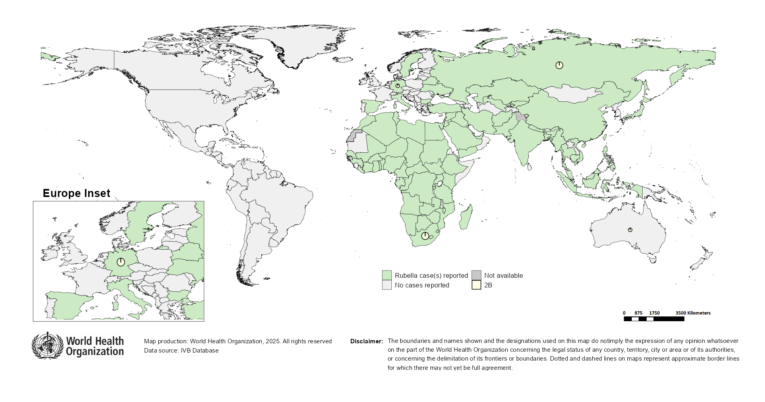
Distribution of rubella genotypes (last 12 months)
Data Source: RUBENS2 database (Genotypes) and IVB Database (Incidence) as of 2025-07-08 and covering the period between 2024-06 and 2025-05 - Pie charts proportional to the number of sequenced viruses

Slide 69
Laboratory

Slide 70
Measles and Rubella IgM Data Summary
2025
Region | Member States* | Specimens received | Measles tested | Measles positive n(%) | Measles equivocal n(%) | Measles negative n(%) | Rubella tested | Rubella positive n(%) | Rubella equivocal n(%) | Rubella negative n(%)
AFR | 39/47 | 26,206 | 22,704 | 6,032 (27) | 389 (2) | 12,033 (53) | 17,084 | 984 (6) | 174 (1) | 11,634 (68)
AMR | 25/35 | 6,993 | 7,048 | 1,251 (18) | 186 (3) | 5,611 (80) | 6,894 | 159 (2) | 64 (1) | 6,671 (97)
EMR | 20/21 | 56,927 | 39,420 | 17,412 (44) | 21 (0) | 21,987 (56) | 33,299 | 509 (2) | 19 (0) | 32,771 (98)
EUR | 42/53 | 20,551 | 17,769 | 8,119 (46) | 96 (1) | 11,447 (64) | 7,277 | 570 (8) | 70 (1) | 6,605 (91)
SEAR | 11/11 | 48,027 | 45,522 | 5,782 (13) | 709 (2) | 39,032 (86) | 43,432 | 1,305 (3) | 355 (1) | 41,768 (96)
WPR | 25/27 | 11,515 | 10,812 | 3,573 (33) | 221 (2) | 6,998 (65) | 8,926 | 265 (3) | 48 (1) | 8,609 (96)
Total | 162/194 | 170,219 | 143,275 | 42,169 (29) | 1,622 (1) | 97,108 (68) | 116,912 | 3,792 (3) | 730 (1) | 108,058 (92)
2024
Region | Member States* | Specimens received | Measles tested | Measles positive n(%) | Measles equivocal n(%) | Measles negative n(%) | Rubella tested | Rubella positive n(%) | Rubella equivocal n(%) | Rubella negative n(%)
AFR | 43/47 | 120,445 | 109,377 | 19,102 (17) | 1,068 (1) | 61,018 (56) | 95,315 | 14,882 (16) | 465 (0) | 51,744 (54)
AMR | 29/35 | 8,102 | 8,411 | 359 (4) | 206 (2) | 7,846 (93) | 7,482 | 176 (2) | 103 (1) | 7,203 (96)
EMR | 21/21 | 116,666 | 98,272 | 38,274 (39) | 129 (0) | 59,869 (61) | 90,051 | 1,468 (2) | 77 (0) | 88,506 (98)
EUR | 44/53 | 159,496 | 137,242 | 78,299 (57) | 404 (0) | 53,578 (39) | 56,088 | 1,305 (2) | 363 (1) | 54,154 (97)
SEAR | 11/11 | 129,727 | 127,549 | 18,898 (15) | 3,678 (3) | 108,724 (85) | 117,938 | 3,087 (3) | 3,040 (3) | 114,106 (97)
WPR | 25/27 | 23,799 | 22,032 | 5,695 (26) | 505 (2) | 15,807 (72) | 17,280 | 601 (3) | 88 (1) | 16,560 (96)
Total | 173/194 | 558,235 | 502,883 | 160,627 (32) | 5,990 (1) | 306,842 (61) | 384,154 | 21,519 (6) | 4,136 (1) | 332,273 (86)
Notes: Based on data received 2025-07 - * Member States Reporting / Total Member States in Region

Slide 71
Supplementary Immunization Activities

Slide 72
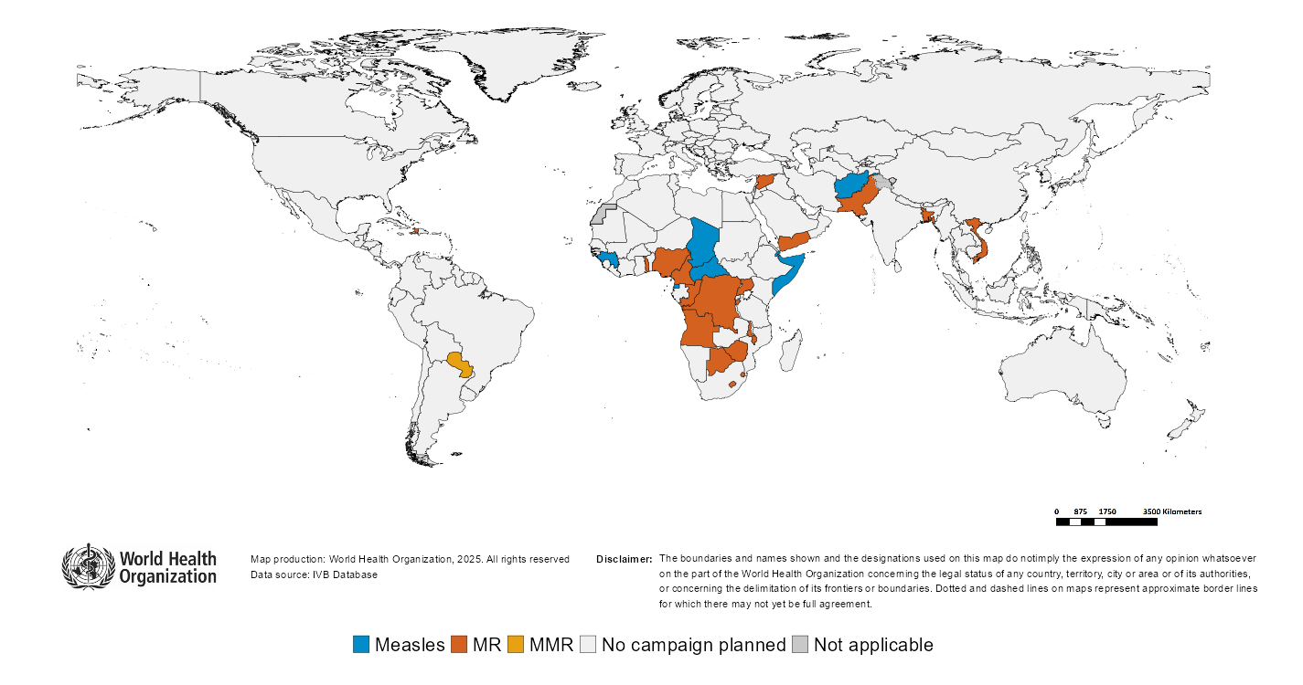
Upcoming MMR, MR and Measles campaigns (2025-2026)

Slide 73
Upcoming MMR, MR and Measles campaigns (2025-2026)
Year | Region | Name | Type | Intervention | StartDate | Status | Age Group(s) | Extent | Target
2025 | AFR | Guinea | SNID | MEASLES | 2025-02-?? | Planned | 0-59 M | SUBNATIONAL | 996214
2025 | AFR | Eswatini | FollowUp | MR | 2025-07-21 | Planned | 9-59 M | NATIONAL | 146141
2025 | AFR | Central African Republic | FollowUp | MEASLES | 2025-10-?? | Planned | 6-59 M | NATIONAL | 1335862
2025 | AFR | Congo | FollowUp | MR | 2025-10-?? | Planned | 9-59 M | NATIONAL | 927595
2025 | AFR | Gambia | FollowUp | MR | 2025-10-?? | Planned | 9-59 M | NATIONAL | 385713
2025 | AFR | Nigeria | CatchUp-SIA | MR | 2025-10-?? | Planned | 9 M-14 Y | NATIONAL | 102539762
2025 | AFR | Zimbabwe | FollowUp | MR | 2025-10-06 | Planned | 9-59 M | NATIONAL | 2518935
2025 | AFR | Lesotho | CatchUp-SIA | MR | 2025-10-22 | Planned | 9-59 M | NATIONAL | 188518
2025 | AFR | Botswana | FollowUp | MR | 2025-11-?? | Planned | 9-59 M | NATIONAL | 223959
2025 | AFR | Chad | FollowUp | MEASLES | 2025-11-?? | Planned | 9-59 M | NATIONAL | 3772072
2025 | AFR | Comoros | FollowUp | MR | 2025-11-?? | Planned | 6-59 M | NATIONAL | 101686
2025 | AFR | Togo | FollowUp | MR | 2025-11-?? | Planned | 9 M-9 Y | NATIONAL | 2201427
2025 | AFR | Uganda | FollowUp | MR | 2025-11-?? | Planned | 9-59 M | NATIONAL | 7685529
2025 | AFR | Democratic Republic of the Congo | CatchUp | MR | 2025-11-26 | Planned | 9 M-14 Y | NATIONAL | 61697195
2025 | AFR | Comoros | FollowUp | MR | 2025-12-?? | Planned | 9-59 M | NATIONAL | 113688
2025 | AMR | Turks and Caicos Islands | VaccinationWeek | MMR | 2025-04-?? | Planned | 5-14 Y | NATIONAL | 100
2025 | EMR | Syrian Arab Republic | FollowUp | MR | 2025-10-?? | Planned | 9-59 M | NATIONAL | 1892447
2025 | EMR | Afghanistan | FollowUp | MEASLES | 2025-11-?? | Planned | 9-59 M | NATIONAL | 16047992
2025 | EMR | Pakistan | FollowUp | MR | 2025-11-?? | Planned | 6-59 M | NATIONAL | 35402182
2025 | EMR | Somalia | FollowUp | MEASLES | 2025-NA-?? | Planned | 9-59 M | NATIONAL | 3200130
2025 | WPR | Viet Nam | OR | MR | 2025-01-?? | Planned | 6 M-15 Y | NATIONAL | 2170542
2026 | AFR | Malawi | FollowUp | MR | 2026-04-?? | Planned | 9-59 M | NATIONAL | 5850406
2026 | AFR | Burundi | FollowUp | MR | 2026-10-?? | Planned | 9-59 M | NATIONAL | 2446535
2026 | AFR | Angola | FollowUp | MR | 2026-NA-?? | Planned | 9-59 M | NATIONAL | 5983408
2026 | AFR | Cameroon | FollowUp | MR | 2026-NA-?? | Planned | 9-59 M | NATIONAL | 4345819
2026 | AFR | Equatorial Guinea | FollowUp | MEASLES | 2026-NA-?? | Planned | 9-59 M | NATIONAL | 229691
2026 | AMR | Paraguay | Campaign | MMR | 2026-10-?? | Planned | 12-59 M | NATIONAL | 509698
2026 | AMR | Haiti | Campaign | MR | 2026-NA-?? | Planned | 9-59 M | NATIONAL | 1236480
2026 | EMR | Djibouti | CatchUp | MEASLES | 2026-NA-?? | Planned | 9-59 M | NATIONAL | 340185
2026 | EMR | Yemen | FollowUp | MR | 2026-NA-?? | Planned | 9-59 M | NATIONAL | 4714060
2026 | SEAR | Bangladesh | FollowUp | MR | 2026-01-?? | Planned | 9 M-14 Y | NATIONAL | 19808176

Slide 74
WHO Bulletins and Newsletters

